Slide 1
Implementing Smart Farming Applications using EO Data, Soil Sensors & Robotics
HE Liaison Webinar on Precision Agriculture& DSS
May 15, 2026
Laboratory in the field

Slide 2
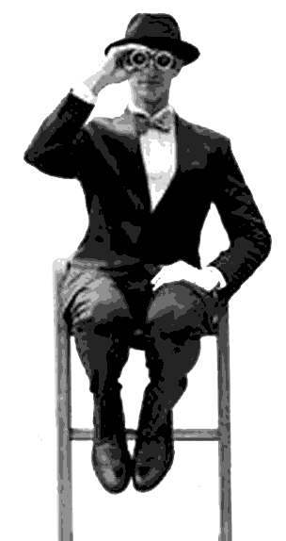
Project details:
01.02.2024. - 31.07.2027. (42 months)
12 partners from 8 countries
7 Use Cases
€ 3 586 760,00

Slide 3

Main objectives:
Improving access to better soil data in agriculture and leveraging its use to make farming more efficient and profitable.
Combining advanced technologies to ensures accuracy, quality, and cost-effectiveness of high-resolution soil data (this includes the unique benefits of Copernicus and Galileo satellite data).
Using novel data we produce to enable new precision agriculture applications.
Creating and bringing to market project results.

Slide 4

The need for SQAT
Challenges in soil management
Soil degradation: Due to intensive agriculture, soil health is declining, leading to lower productivity and increased environmental risks.
Lack of precision data: Many farmers rely on generalized soil data rather than site-specific insights.
Time-consuming & costly analyses: Traditional soil testing methods are expensive and labour-intensive.
Climate change impact: Unpredictable weather patterns are affecting soil conditions, requiring adaptive management strategies.

Slide 5
Our solution:
To develop a flexible smart soil mapping system by:
Combining satellite data and on-field sensing techniques:
  1. Use satellite images (from EU’s Copernicus programme) to estimate soil variability within a field.
  Use this estimate to more efficiently “drive” proximal sensors on the field (route width, track planning) and obtain precise measurements of field values.
  combine satellite images from in field measurements (as covariates through data fusion) to generate high quality soil property maps at a lower cost than current practice.
Automating field operations using robotics:
  Autonomous sensor-based soil mapping mounted to a field robot, and
  An on-site “laboratory in the field” with a robotic soil drill and an extraction chamber for wet chemical nutrients extraction and analysis, including ion-selective electrodes and a colorimeter for assessing soil properties.
And 5 Smart Farming Applications making use of improved soil mapping to deliver novel value to farmers.

Slide 6
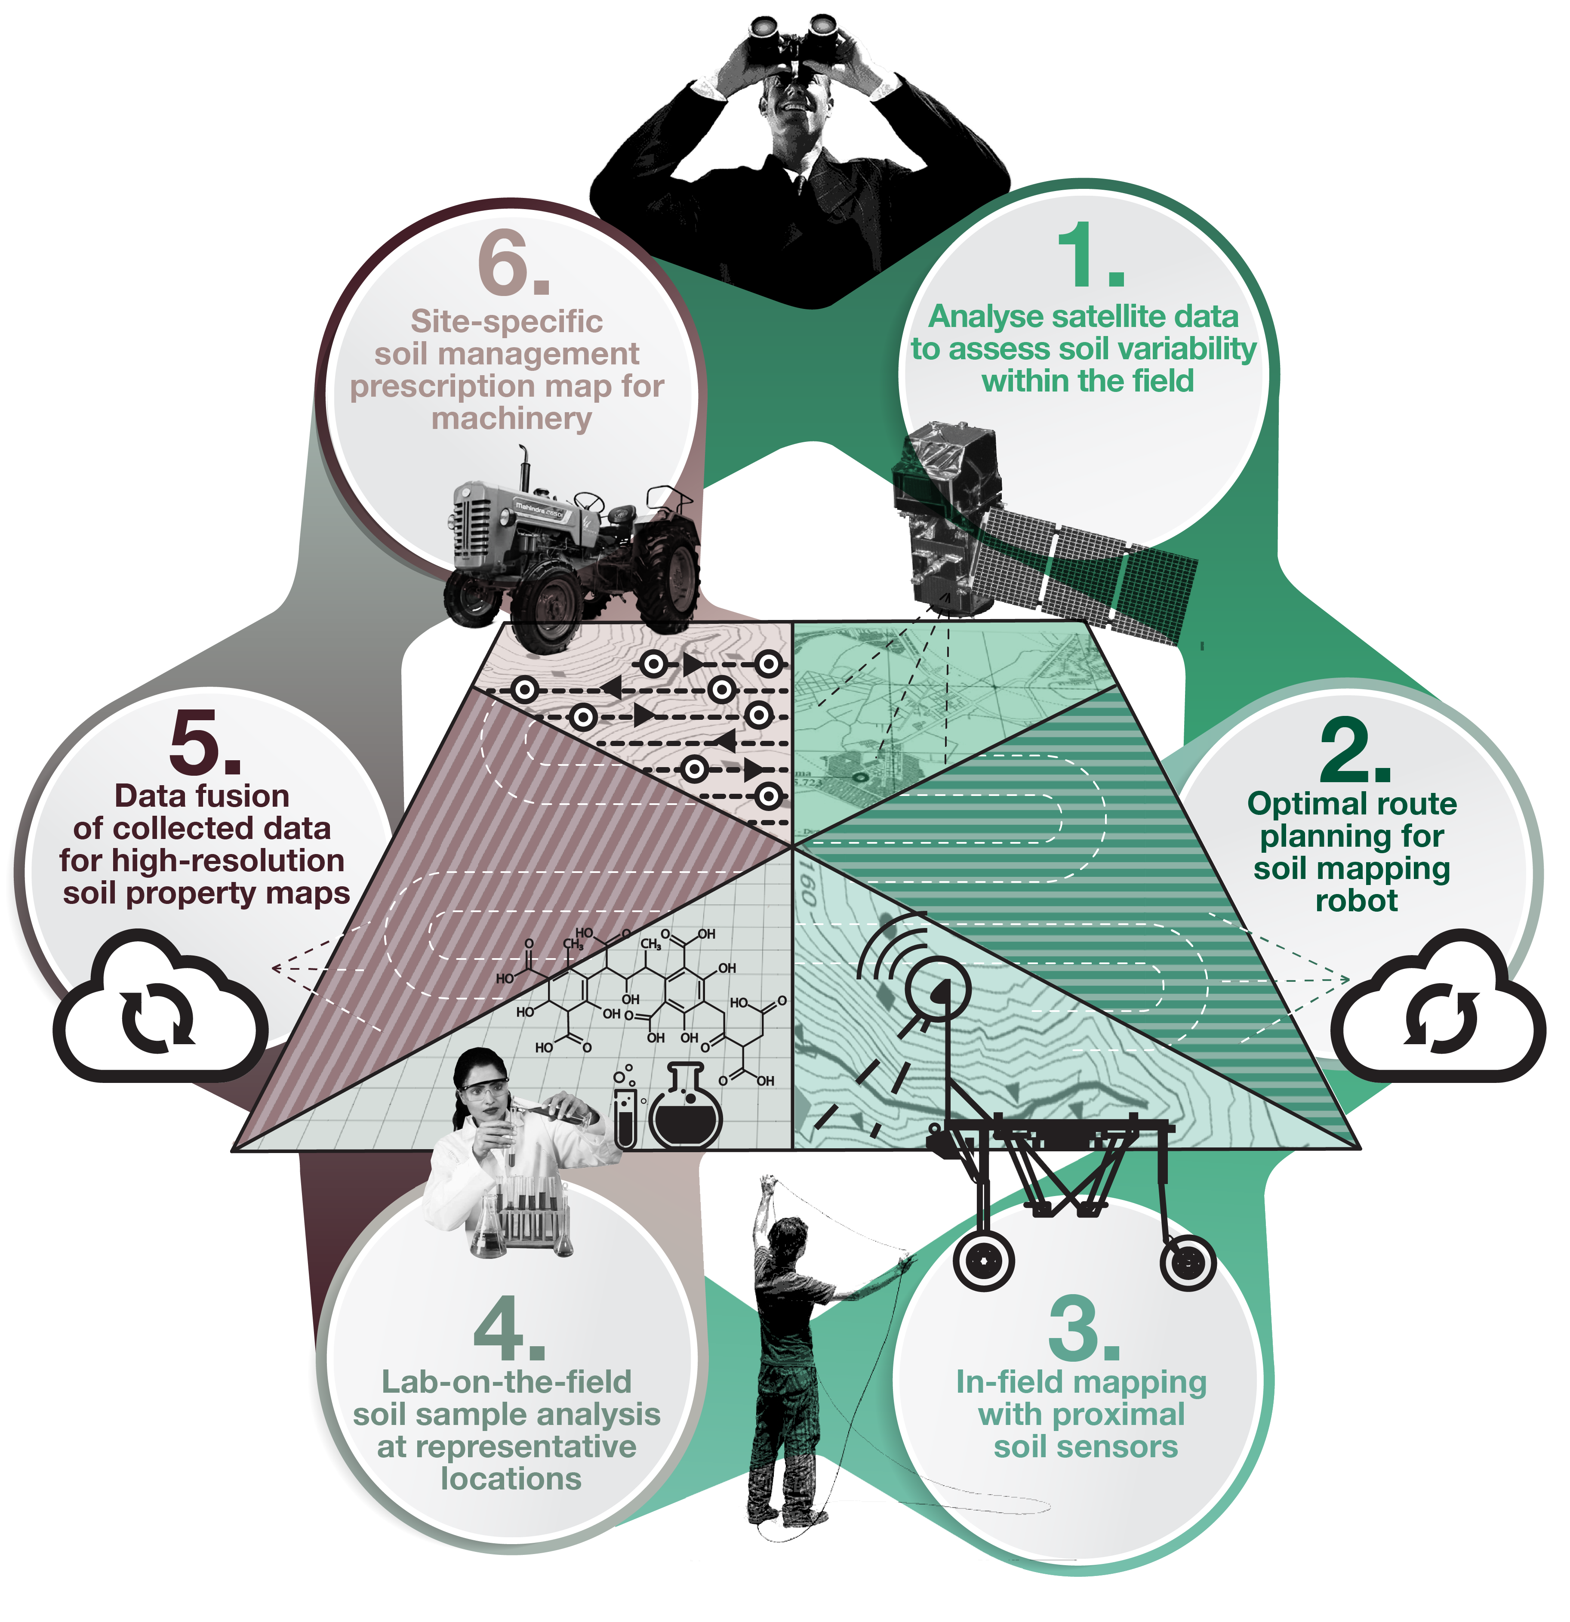
SQAT at a glance:

Slide 7
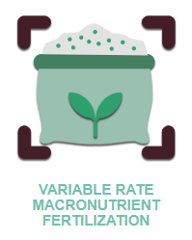
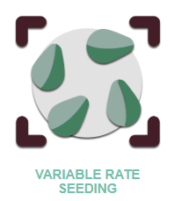
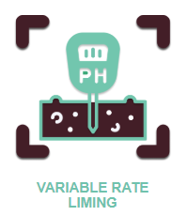
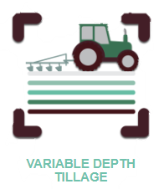
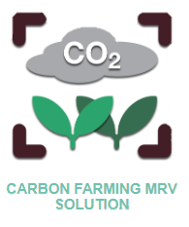
5 Smart Farming Applications
Calculate precise liming needs in different field zones and apply lime in different quantities for each zone to meet needs.
Automate on-field soil properties testing for select macro
nutrients to automate/
optimize mapping operations.
Optimized seeding density based on soil properties, reducing costs while enhancing plant yield and quality
To avoid soil compaction and optimize fuel efficiency, subsoiling is performed only where needed and at the correct depth.
High-resolution, accurate soil carbon estimation for a science-based, practical, and cost-effective carbon monitoring approach

Slide 8
7 Use Cases
Belgium: Prevention & remediation of soil compaction and acidity
Germany: Variable-Rate Liming to Optimize Crop Yields and Improve Resource Efficiency
Ireland: Milk supply chain sustainability with Regenerative Agriculture practices
Netherlands: Improved soil management & profitability for intensive potato farming
Serbia: Improving soil management to reverse long-term trends of declining fertility.
Switzerland: Smart soil sample collection and on-field nutrient analysis in Switzerland
Ukraine: Higher resource efficiency and yield resilience to safeguard food security.

Slide 9
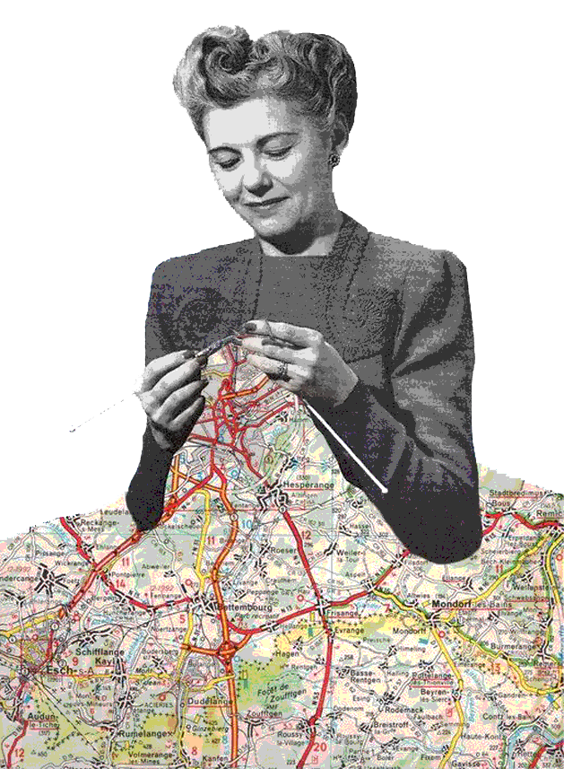
Future of SQAT:
Scaling up and commercialization
Refining algorithms for broader geographical adaptability.
Developing user-friendly smart farming applications for farmers.
Expanding partnerships for cross-border implementation.
Integration with EU and global Initiatives
Aligning with Horizon Europe’s soil health mission.
Supporting carbon farming through improved soil monitoring.

Slide 10







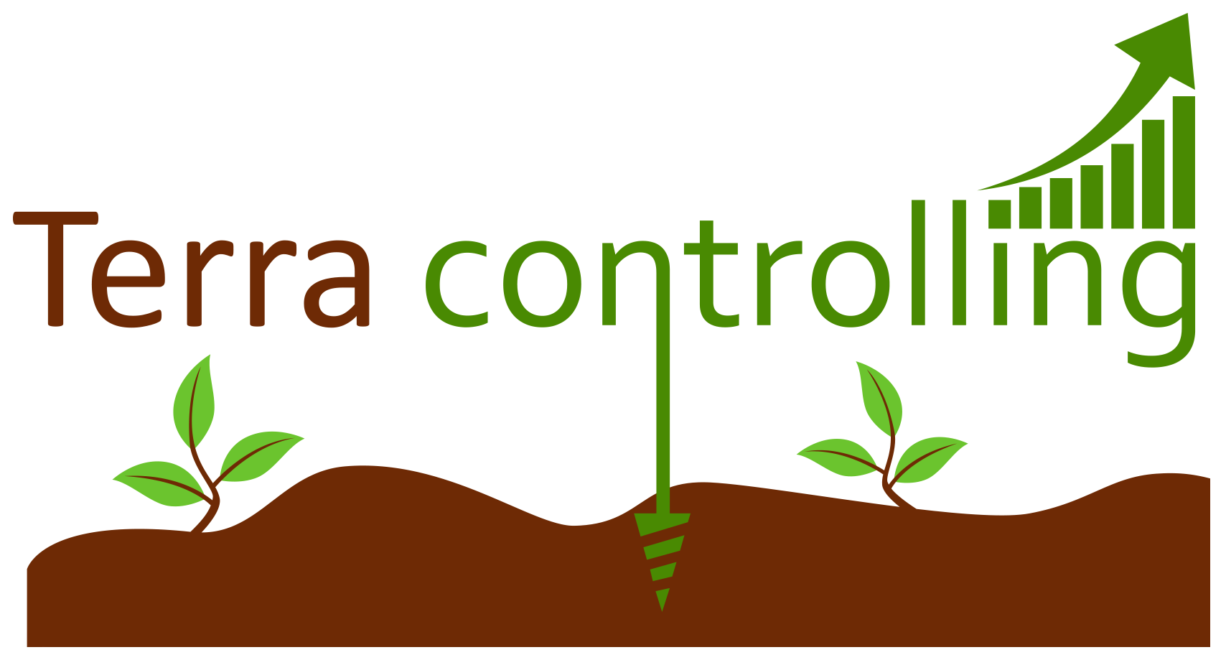


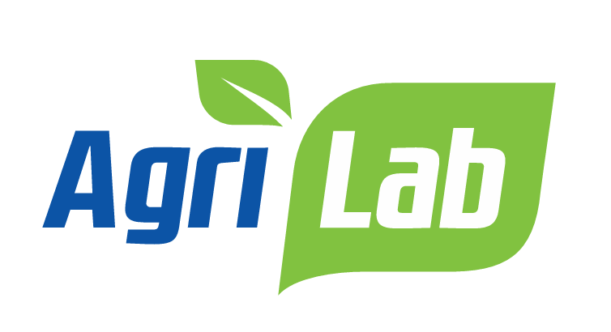


Partners:

Slide 11
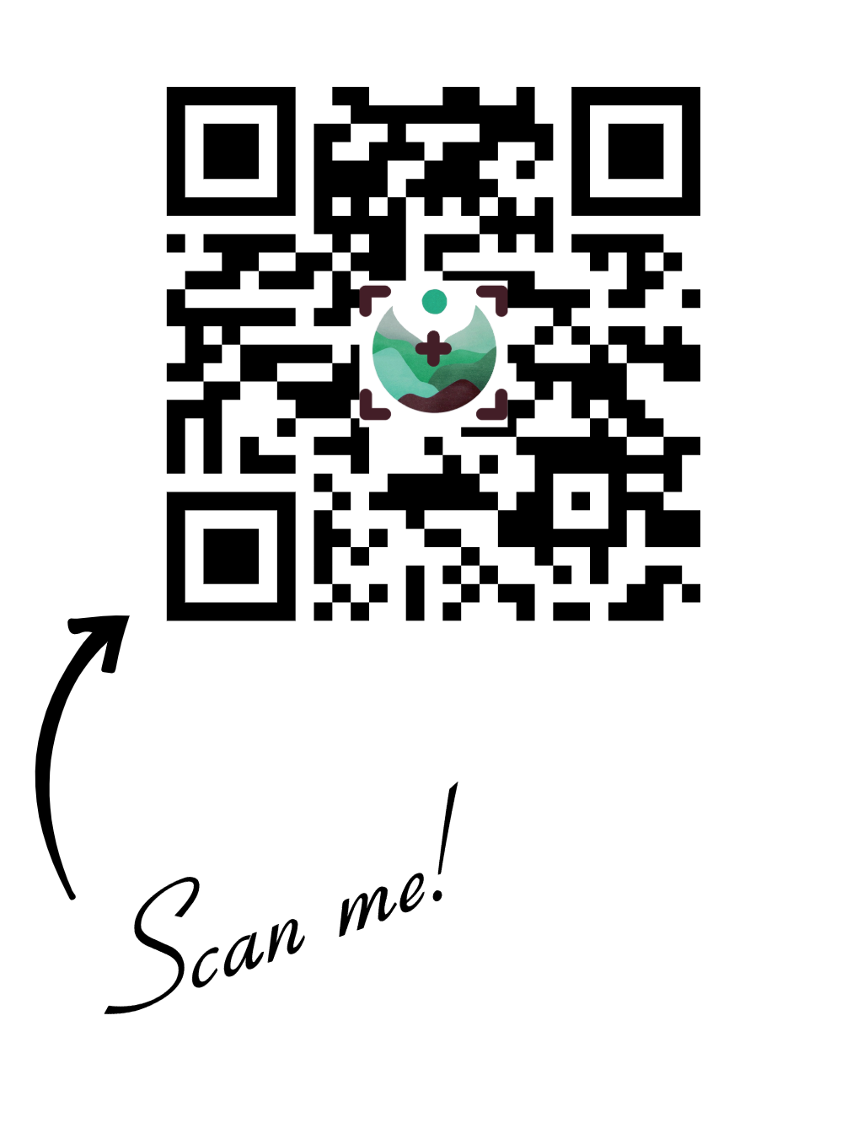

📩 Stay connected!
Follow us for updates, insights, and collaboration opportunities!

