Slide 1
Project Overview
Freya De Keyzer, Erasmus University Rotterdam

Slide 2
Outline
In a nutshell
Our consortium
The problem in context
Current state of EU policies
What we aim to achieve
How we will make this happen
Our intervention cases
Stakeholders and their involvement
Impact

Slide 3
In a nutshell
PROGRAMME | Horizon Europe
GRANT AGREEMENT | No. 101136507
CALL | HORIZON-CL6-2023-COMMUNITIES-01
TYPE OF ACTION | HORIZON Research and Innovation Actions
DURATION | 48 months
BUDGET | 6,496,857.50€

Slide 4
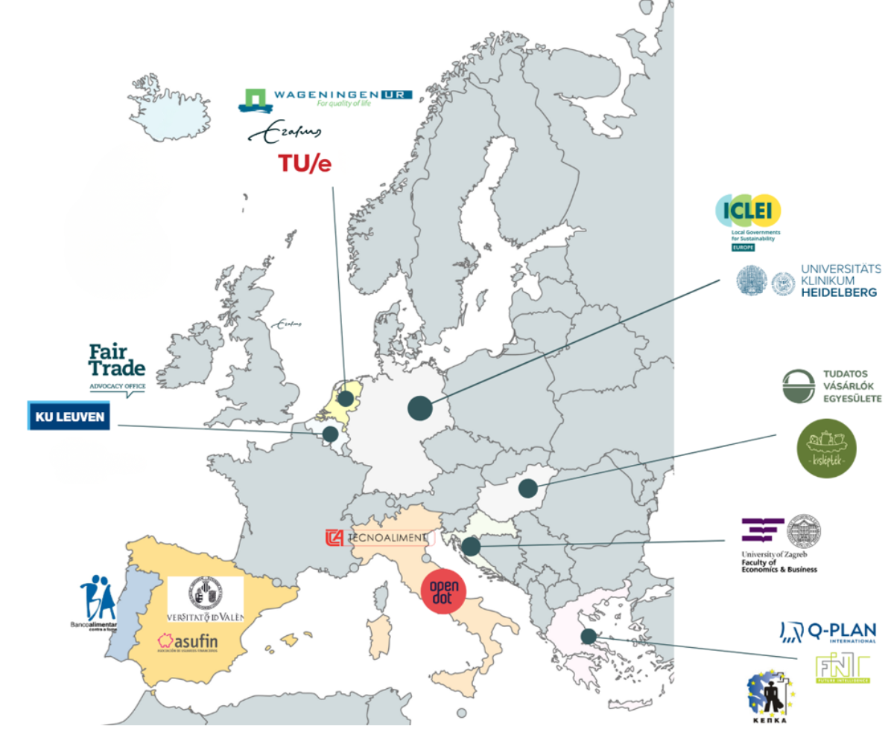
Our consortium
18 partners across 9 countries
Universities
Consumers’ organisations
Food organisations
SMEs

Slide 5
The problem in context
Environment: The current food system contributes to global warming, accounts for a third of greenhouse gas emissions, and uses 70% of freshwater, harming ecosystems and biodiversity.
Society: Poor diets cause 75% of non-communicable diseases and 85% of deaths in Europe. Meanwhile, 88 million tons of food are wasted annually, and 8.6% of Europeans can't afford a proper meal every second day.
Economy: A few major corporations dominate the global food system, leading to unequal profit distribution and disadvantaging small suppliers.

Slide 6
Current state of EU policies
The European Green Deal and Farm to Fork Strategy have introduced a new EU framework to transition to a healthy, fair, and eco-friendly food system.
Market transparency and tackling greenwashing are priorities in the New Circular Economy Action Plan and New Consumer Agenda.
Consumer choices for sustainable food are vital for the EU's 2030 and 2050 climate goals. The Green Deal Industrial Plan emphasizes providing reliable sustainability information.

Slide 7
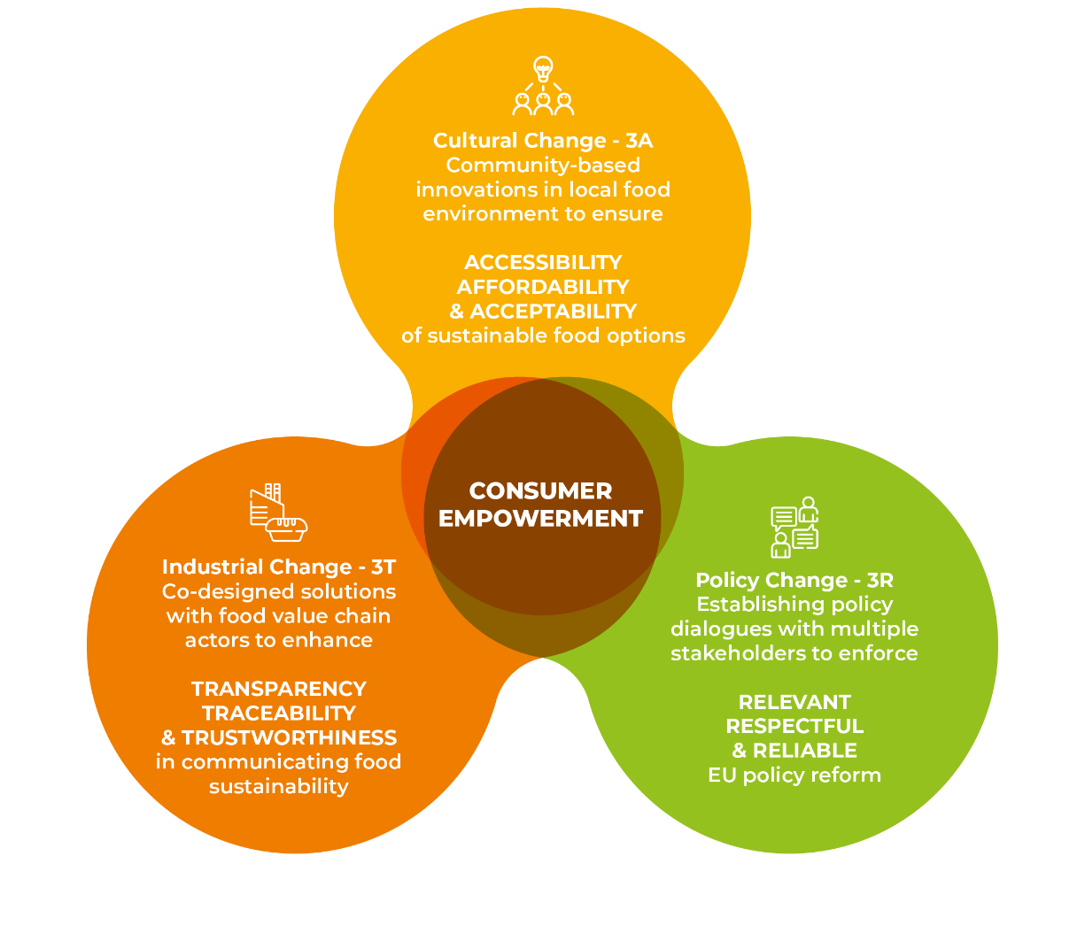
How we will make this happen
CUES will foster a Triple Change in the food system concerning culture, food value chain, and policy aiming the consumer empowerment.

Slide 8




What we aim to achieve
Co-design methods and approaches to guide and change consumer behaviour and determine the persuasive cues to promote sustainable consumer behaviour.
Empower food value chain actors to make, distribute, and promote sustainable food options.
Increase consumers’ understanding about food safety, labelling, and circular systems, as well as the impact of their own eating habits.
Establish policy dialogues with multiple actors and set up an advisory board to inform food system governance.

Slide 9
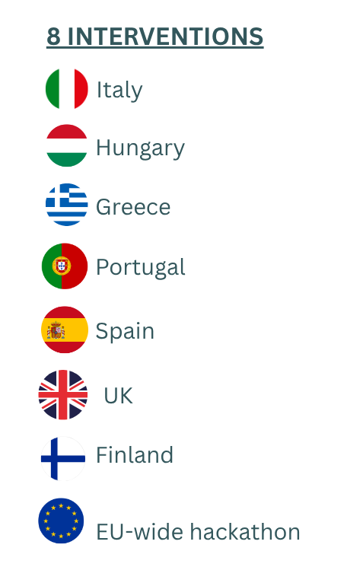

Our intervention cases
CUES partners will develop 8 intervention cases involving consumers, actors in the food value chain, and decision-makers in 7 European countries plus an EU-wide hackathon.
The food value chain stakeholders’ intervention cases aim to increase the transparency and traceability of food labelling and promote consumer trust.
The consumer-centred and community-led intervention cases to engage consumers across all cultural, demographic, and socio-economic backgrounds in the transition to a sustainable food system.
Read more: https://cuesproject.eu/intervention-cases/

Slide 10
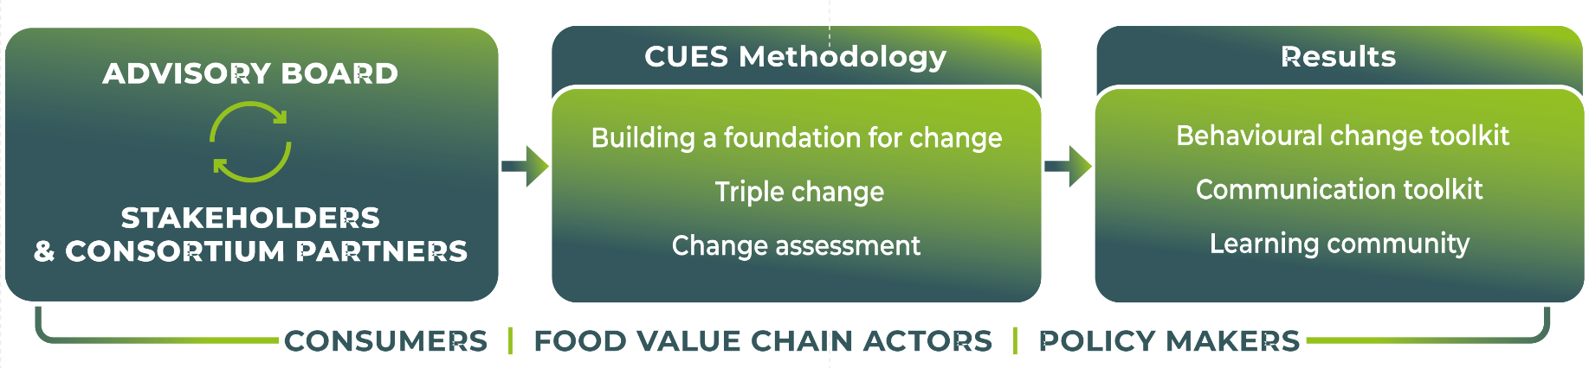
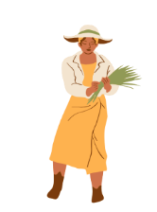




Stakeholders and their involvement
Consumers
Stakeholders in the
food value chain
EU Policymakers
Academics
Actors in the social innovation sector

Slide 11






Impact
Nutrition: Increase sustainable food consumption for three (3) million consumers.
Food: Reduction of global food waste.
Cultural: Improved consumers’ perceptions of desirability of sustainable food options.
Food value chain: Improved scalability of sustainable food business models.
Policy: Enhanced policies for transition to sustainable food system.
Academic: Training methods and insights to study sustainable food consumption.

Slide 13
