Slide 1


Artificial Intelligence and its Practical Application in Business
Rokas Jurkėnas CEO & Founder
@ Idea Link, QualifyHQ

Slide 2

November 30, 2022:
The Day Everything Changed

Slide 3







The Common AI Use Cases We All Know
Writing Posts
Email Responses
Generating Images
Content creation at scale
Professional communication
Ghibli everything
Quick Answers
Summarizing Data
Perplexity vs Google
Instant information retrieval
Get key information fast
Changing the search game

Slide 4



Agenda
The Current State of Generative AI
AI Applications Across Departments and Industries
Implementation and Considerations

Slide 5
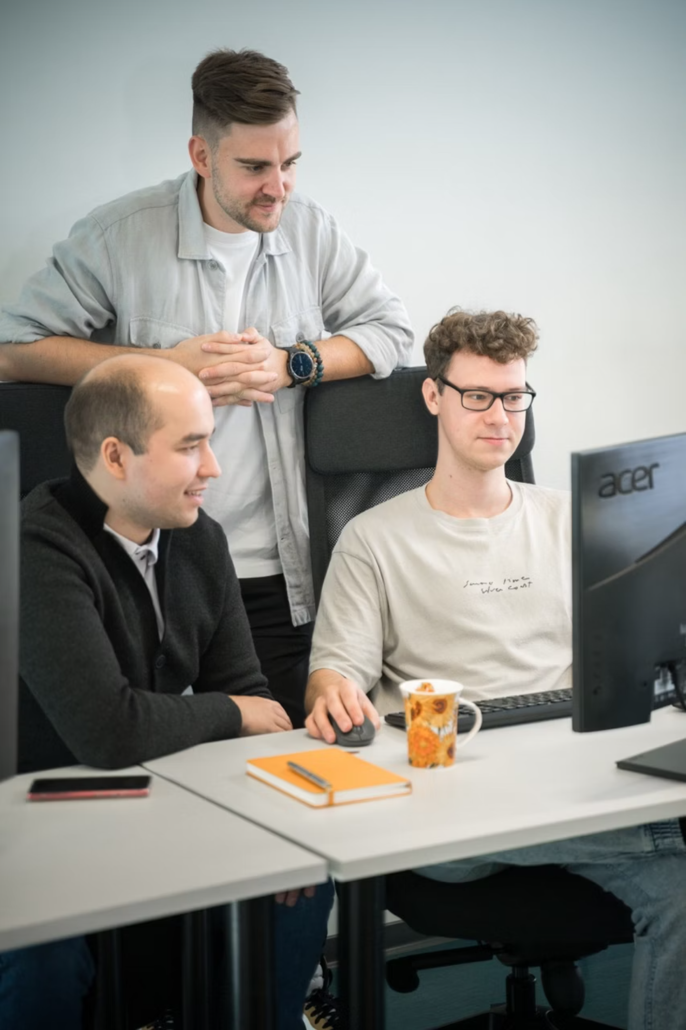



About me
AI Product Development
Over 100+ digital products developed
AI Strategic Consulting
We help companies turn AI into ROI
AI Process Automation
Fully automate manual tasks with AI agents

Slide 6
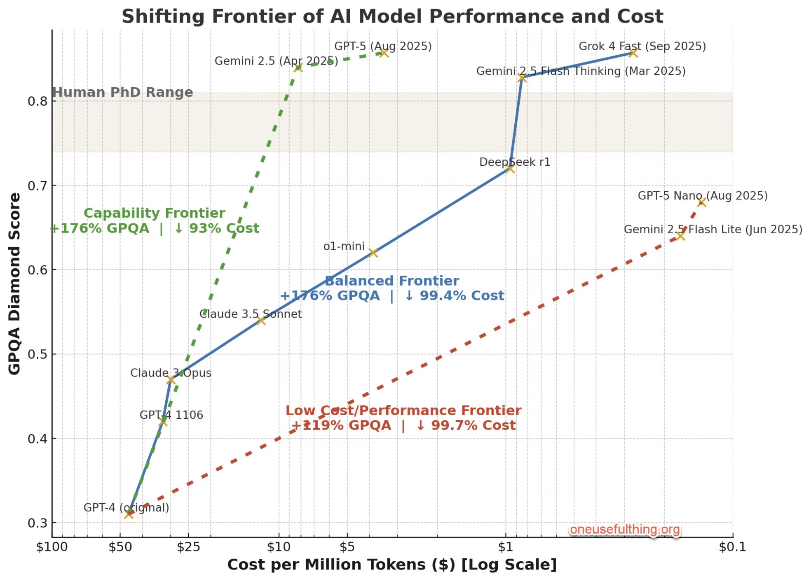
We don't realise that model got MUCH smarter at a 99.4% lower cost.
Source: Ethan Mollick, 2025 Sep 21st https://x.com/emollick/status/1969845283816161726/photo/1

Slide 7

Jevon's Paradox → Lower Prices → More Use

Slide 8
Addressing the Elephant in the Room:
The MIT "95% Failure" Study
The Reality Behind the Headlines:
Study Methodology
Definition of "Failure"
Based on only 52 interviews (convenience sample)
No sustained P&L impact within 6 months
Missing Details
No clear explanation of how "failure" was coded

Slide 9

The 95% Accuracy Rule
Start where 95-98% accuracy delivers ROI, not where you need 100% perfection

Slide 10
Where Generative AI Works Best
🟢 Best Use Cases
🟡 Needs Human Judgment
🔴 Hard to Use
(Deploy with Confidence)
(AI + Human Partnership)
(Avoid or Use with Extreme Caution)
Content generation
Customer service
Document processing
Legal review
Real-time crisis management
Translation and transcription
Medical screening
Regulatory compliance
Code generation
Financial analysis
Child care/therapy
Research assistance
HR screening
Financial transactions
Template work
Strategic planning
Original scientific research

Slide 11

AI applications across departments and industries

Slide 12









Customer Support: Basic AI Applications
AI Chatbots for Tier 1 Queries
AI Tools for Information Retrieval
Call Transcription & Data Collection
Foundational Automation Tasks
Automated responses for FAQs from knowledge bases
Guiding internal users to find relevant information quickly,
Transcribing customer interactions and collecting essential data
Simplifying routine processes such as checking order status.

Slide 13






Customer Support: Advanced AI Applications
AI Phone Agents
Smart Call Routing
Action Automation
Complex Voice Interactions
Intent & Sentiment Analysis
Bookings, Refunds, Updates
Agent Co-pilots
Workflow Automation
Real-time Contextual Support
Seamless Multi-step Journeys

Slide 14

A team of voice agents in action

Slide 15
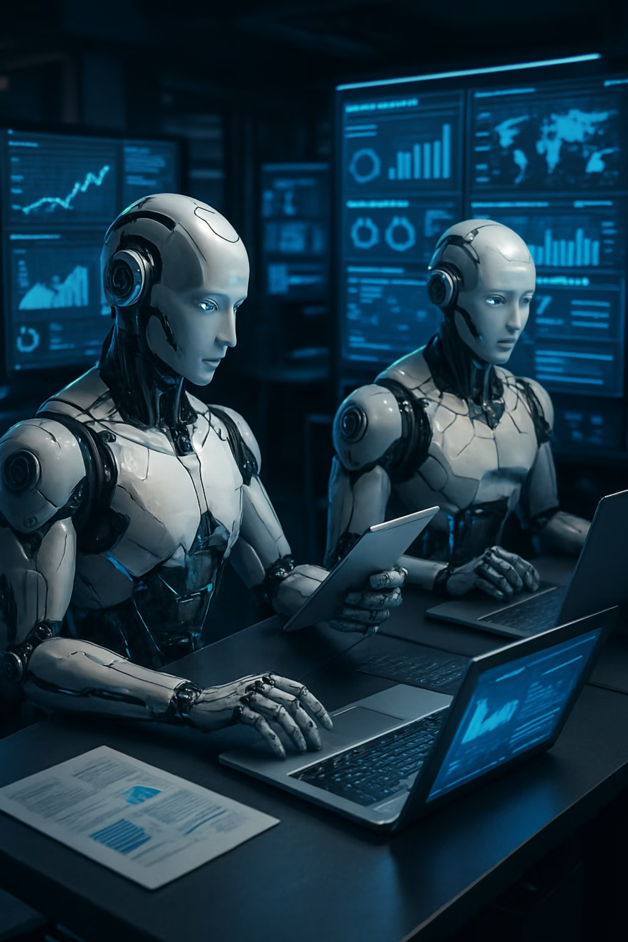
AI in Sales
QualifyHQ - Get Qualified Leads Instantly
Automated prospect research and qualification
EverGrowth - Agentic GTM system
AI-powered go to market system
Agent Frank - AI SDR
Tailored outreach at scale

Slide 16
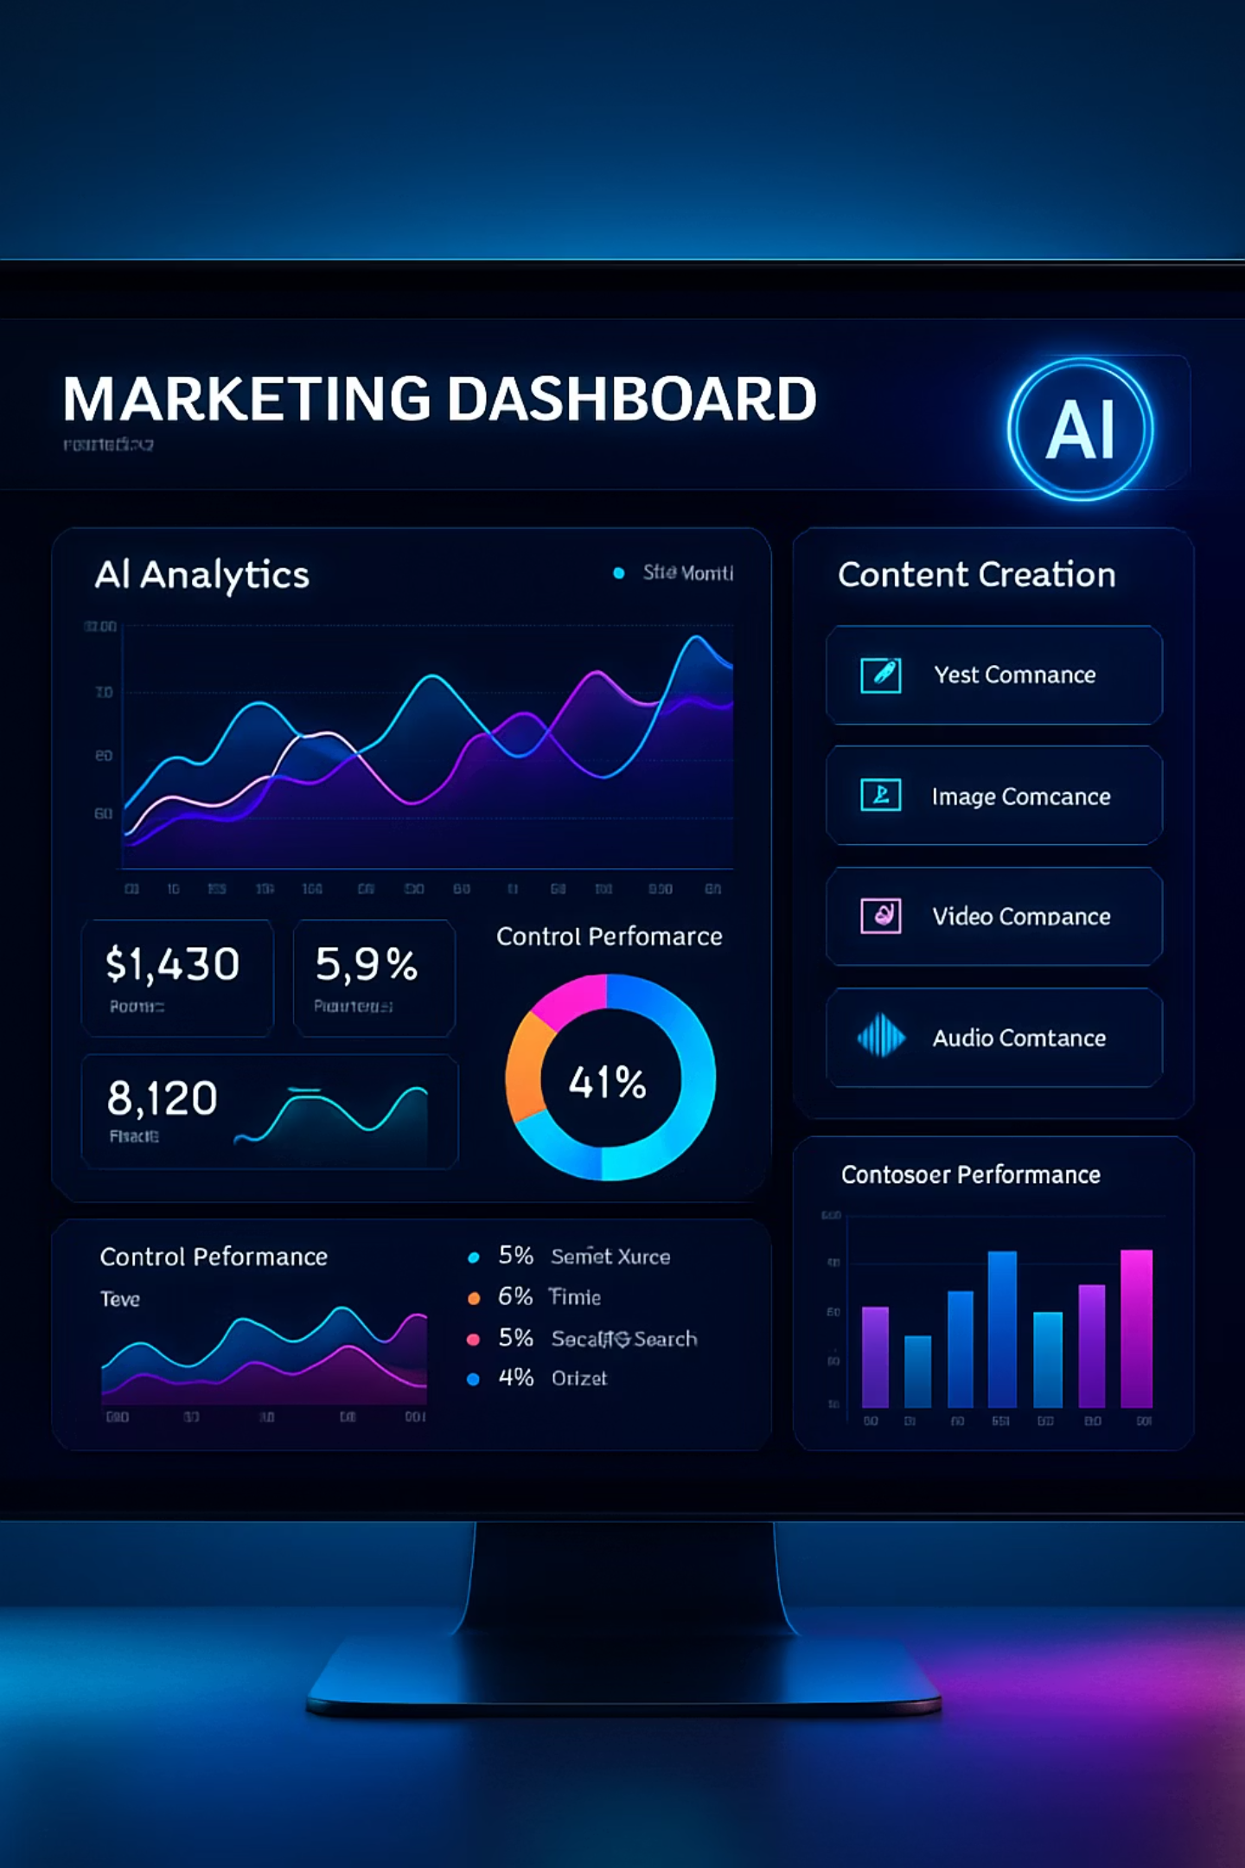



AI Based Marketing
SEObotAI
Captions.ai
Arcads.ai
Automated SEO article research, writing and planning
Realistic UGC content generation by AI
Winning ads created by AI

Slide 17
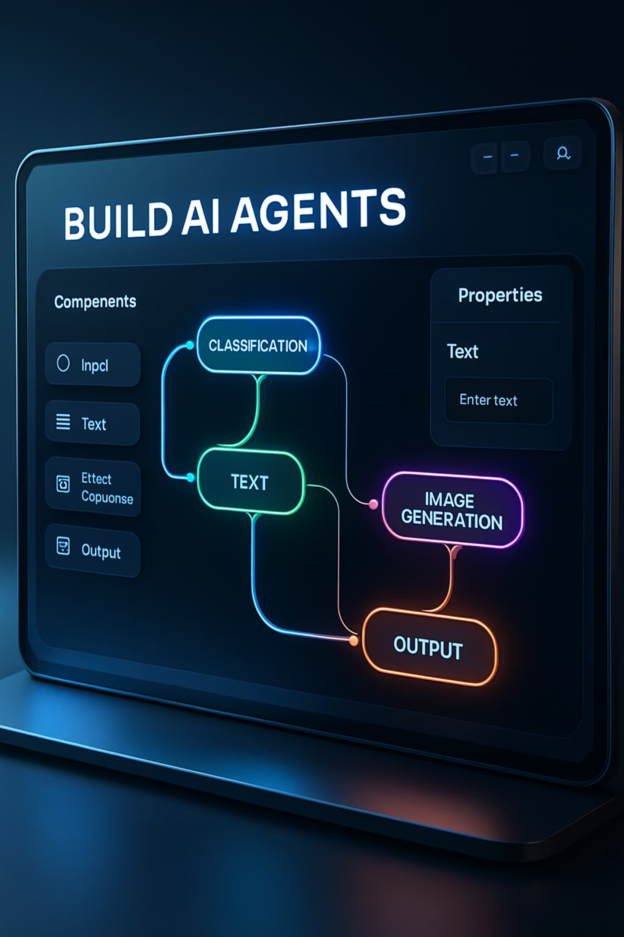
Operations: Unstructured Data Processing
Invoice processing
Contract analysis
PDF → internal system
Key terms, risk flagging, renewals
Purchase order matching
Compliance documentation
Three-way automated matching
Scattered data → structured reports

Slide 18
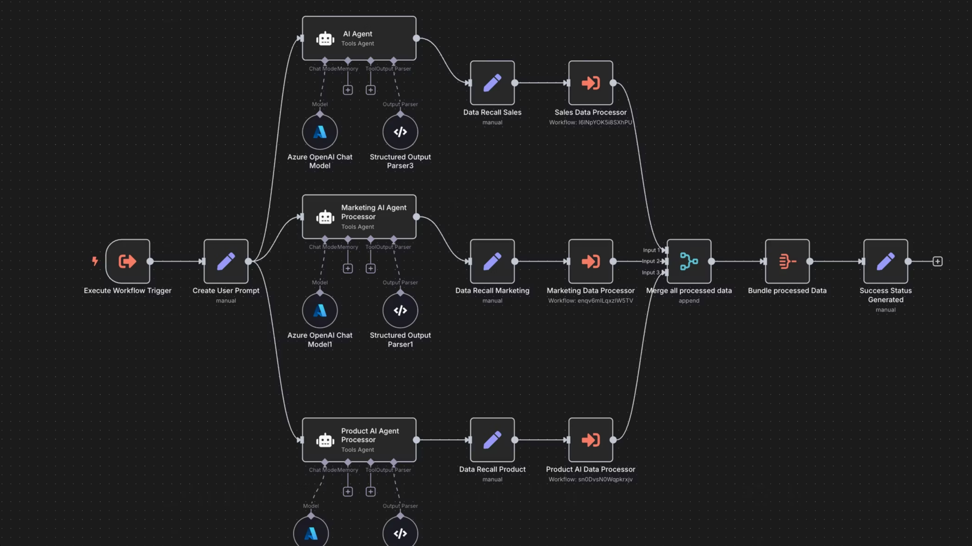

Slide 19
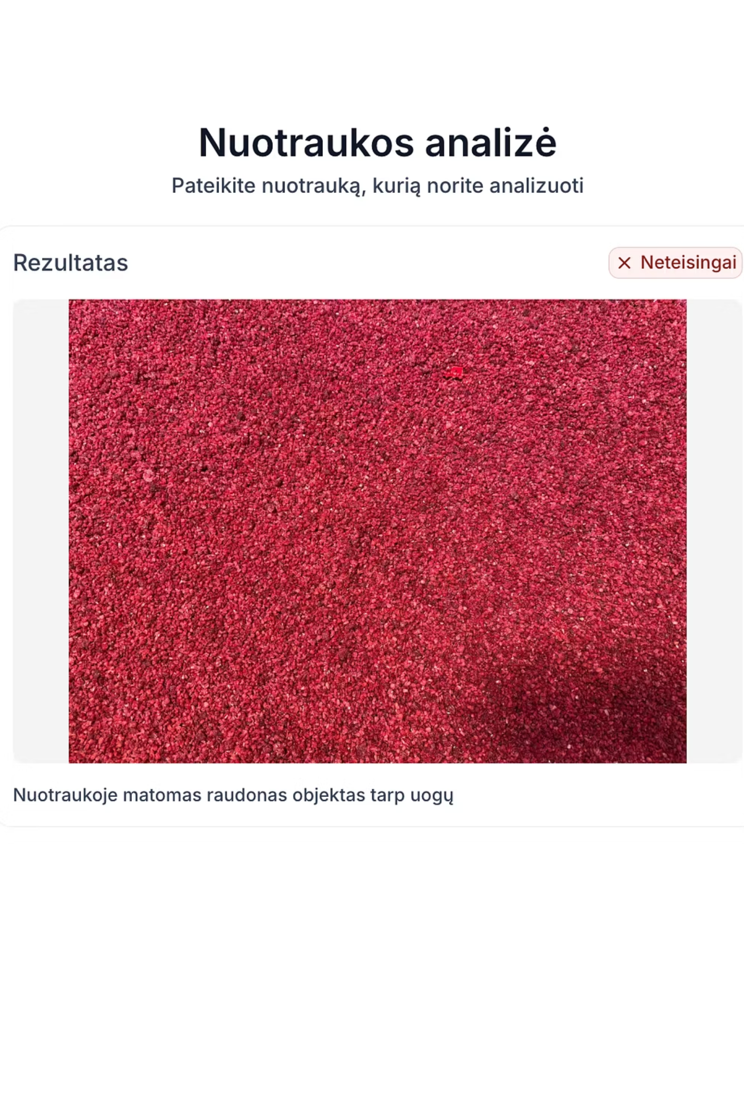
AI in Quality Control
1
Vision Systems
VLM technology implementation
2
Quality Control in Factories
Visual analysis (like a human)
3
Defect Detection
Real-time manufacturing optimization

Slide 20
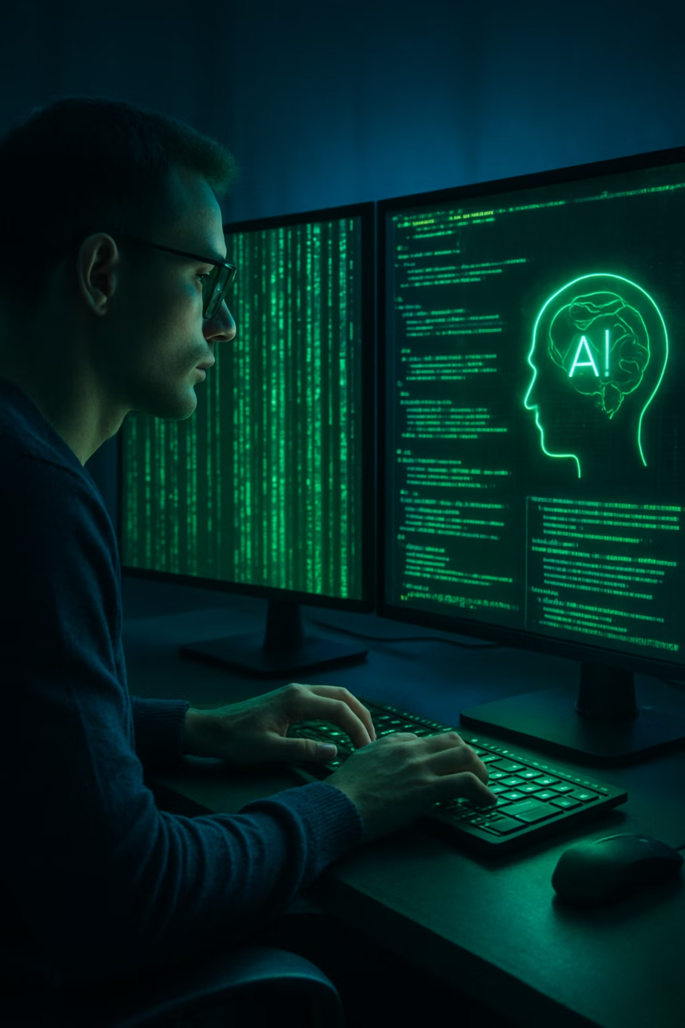








AI in Software Development

Slide 21
HR: Administrative Overhead Elimination
Employee Self-Service & Recruitment
Policy Q&A chatbot: Benefits, holidays, procedures
Document automation: Offer letters, onboarding checklists
Resume screening: First-pass candidate filtering
Screening calls: Second-pass of candidates

Slide 22
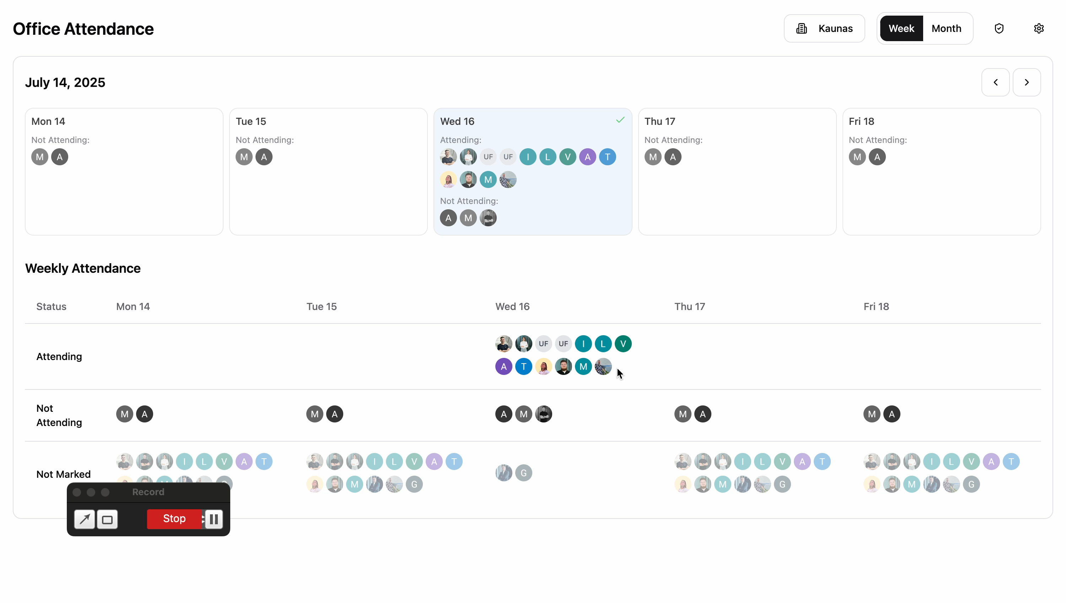
Bespoke Internal Systems

Slide 23









AI for Research

Slide 24




Legal: From Grunt Work to Strategic Counsel
Contract Review
Regulatory Monitoring
First-pass analysis, missing clause detection
1
2
Industry-specific regulation tracking
Legal Research
4
3
Policy Generation
Case law summaries, precedent analysis
Company guideline drafts

Slide 25
Finance & Accounting
Transaction Processing & analysis
Expense processing: Receipt OCR + categorization
Financial reporting: Natural language summaries
Audit preparation: Document search and organization
Reconciliation: Automated categories matching across systems

Slide 26
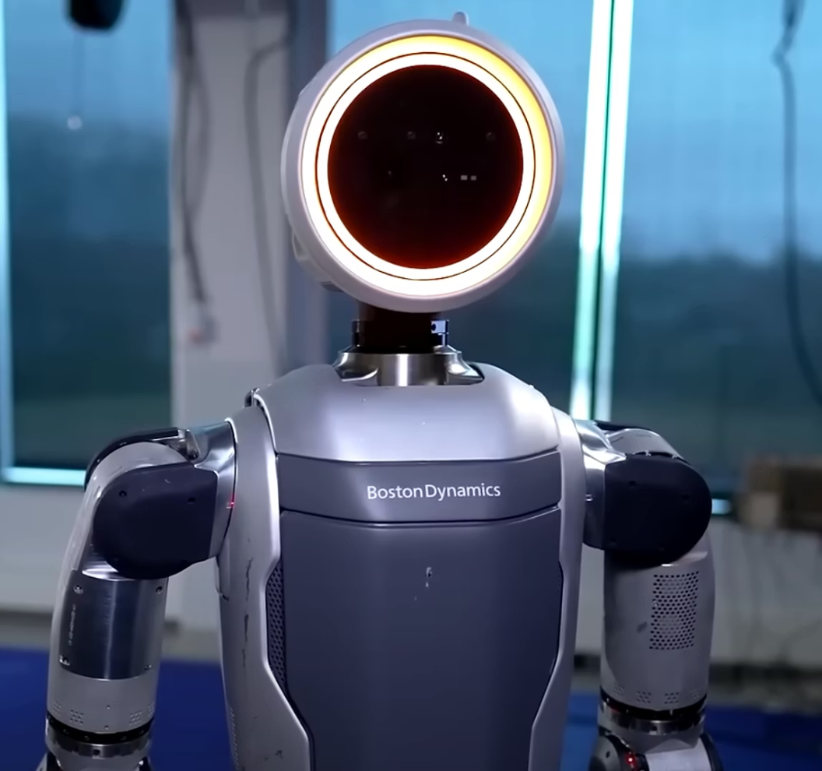
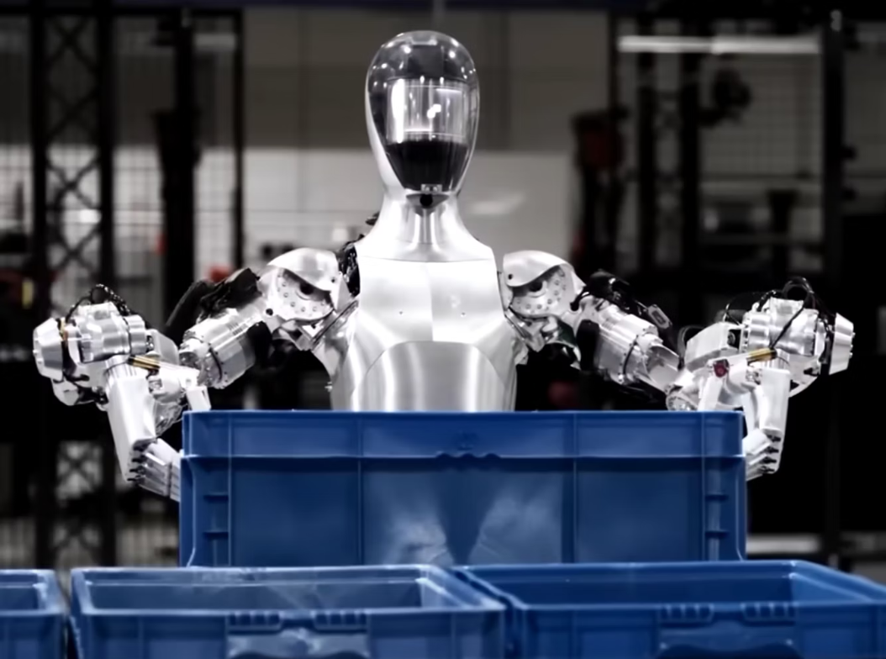
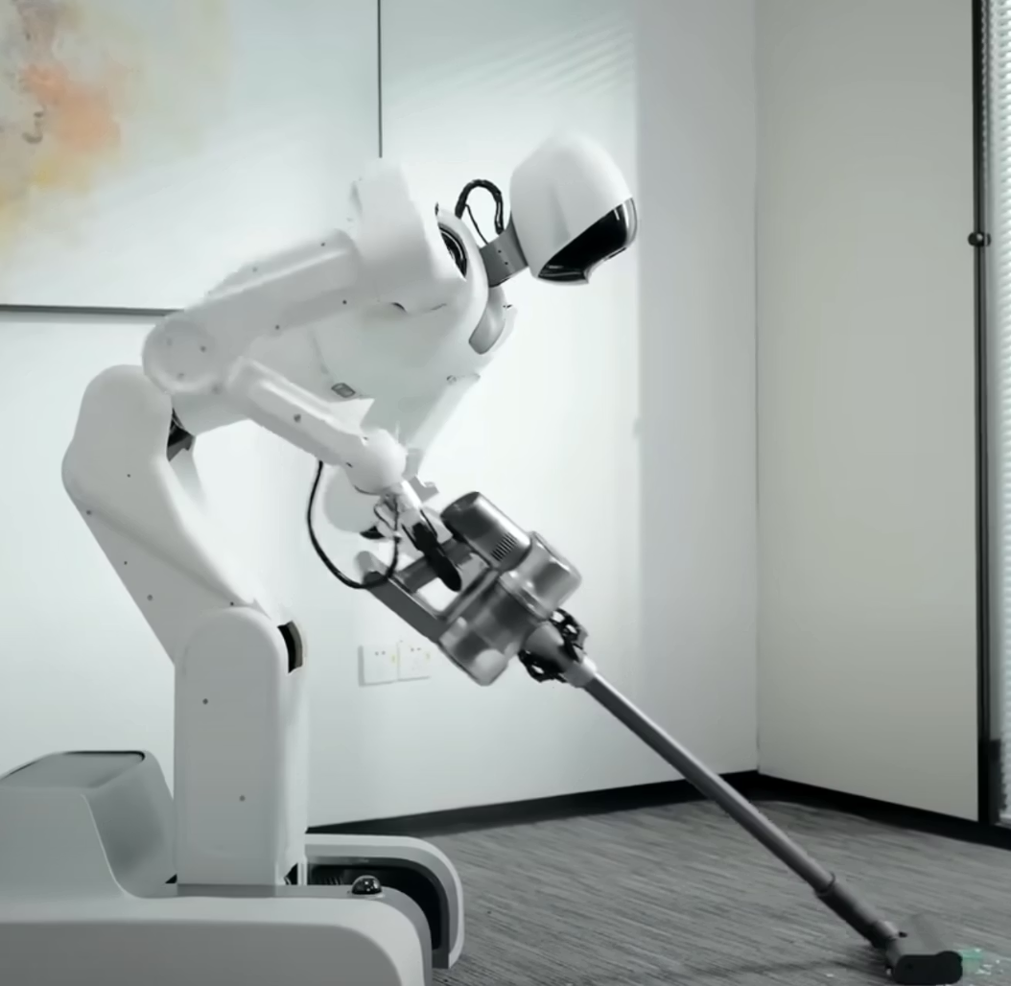
Bonus: Robots Breakthrough

Slide 27
Implementation Strategy: Enterprise Roadmap
3
2
1
Phase 3: Strategic Augmentation (6-12 months)
Phase 2: Human + AI Partnership (3-6 months)
Phase 1: Best Use Cases - Quick Wins (30-60 days)
Success Factors
Start conservative: 95% accuracy targets
Data foundations: Clean, accessible data first
Change management: Employee buy-in essential
Continuous monitoring: Track accuracy and ROI

Slide 28



Enterprise Security & Implementation Requirements
Google Cloud Vertex AI
Microsoft Azure AI Services
AWS Bedrock
Enhanced Privacy Controls
Data residency: Your data stays within your chosen cloud region
Training data separation: Your conversations don't train public models
Compliance frameworks: SOC 2, GDPR, HIPAA, ready
Compliance Considerations
Financial Services: Additional regulatory oversight required
Healthcare: HIPAA compliance essential for patient data
EU Operations: GDPR data processing agreements necessary

Slide 29






Never Use Consumer AI Services (ChatGPT, Claude, DeepSeek) For:
Confidential Business Information
Customer Data or PII
Regulated Industry Workflows

Slide 30





Start Taming AI
Pick one benchmarkable process
From the green category
Measure current cost
Time + errors + employee satisfaction
Run focused pilot
With human oversight
Scale based on results
Expand to similar processes
Department Priority Matrix
Highest ROI first: e.g. Operations (document processing)
Most visible wins: e.g. Customer support automation
Strategic advantage: e.g. Full-scale custom internal system for source of truth

Slide 31

Thanks for listening!
If you have any questions - happy to connect on Linkedin/ via email.
Let's connect!
Email: rokasj@idealink.tech
LinkedIn: https://www.linkedin.com/in/rokasjurkenas/

