Slide 1




Automated Image Classification and BalticGTIF Sustainable Resource Management – Carbon Footprint Accounting Projects
EOX team: Bernadett Csonka, Dr. Gerhard Triebnig, Stefan Brand, Anne Gruböck, Martin Gruböck, Stefan Achtsnit, Silvester Pari, Elias Wanko, Nikola Jankovic;
GeoVille team: Dr. David Kolitzus, Donvan Grobler, Edurne Estevez

Slide 2
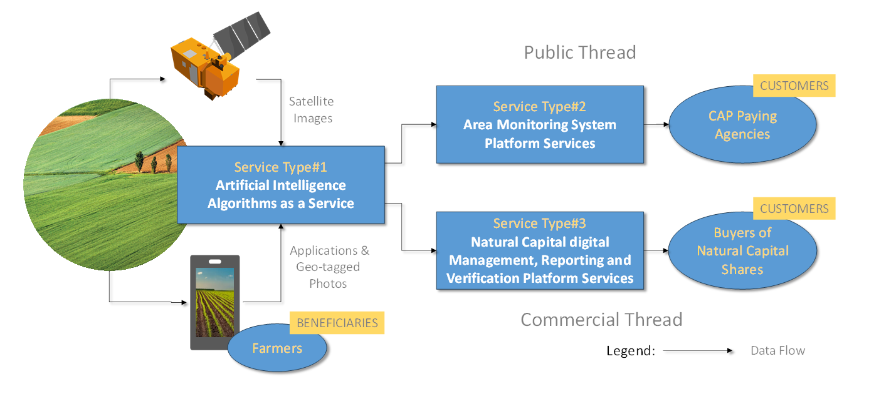

Service Architecture Overview
Business propositions are pitched per individual “Service Type”

Slide 3




Service Types to support performance based CAP & nature values:
1. Automatic processing of geo-tagged photos (GTPs):crop type and event identification and classification tp support AMS
2. Integrating the GTPs content into ML algorithms for deriving enhanced AMS products + visualizing the progress in AgriApp viewer
3. Natural Capital Solutions (NCS) – carbon, biodivestity, high-species rich grassnads - Measurement, Verification, Impact Evaluation & Validation
ESA/ARTES 4.0 Downstream Applications Demonstration
Department of Agriculture, Food and the Marine

Slide 4
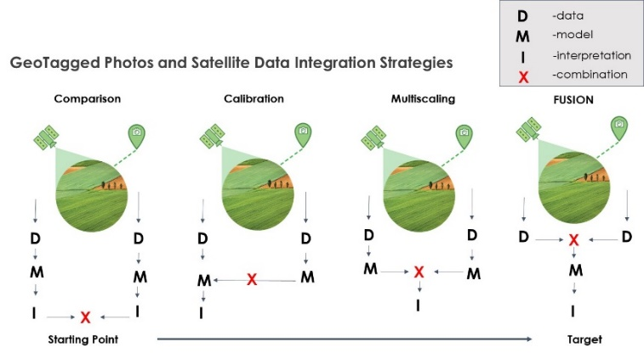
GTP and satellite data integration
New generation of AI models opens a new logic of training/testing and validating AI solutions of EO data.
Credibility and transparency:
“Explainable AI”
model validation methods: ML-probabilities + class-level independent validation of
  each data processing step
  the model used to derive AMS markers
  combined final result per agricultural parcel
Supervised classification training/test data as input
ML classification:
GTP is manually integrated into the population
CwRS - CAPI
GTP is an automatically labeled input data of ML

Slide 5


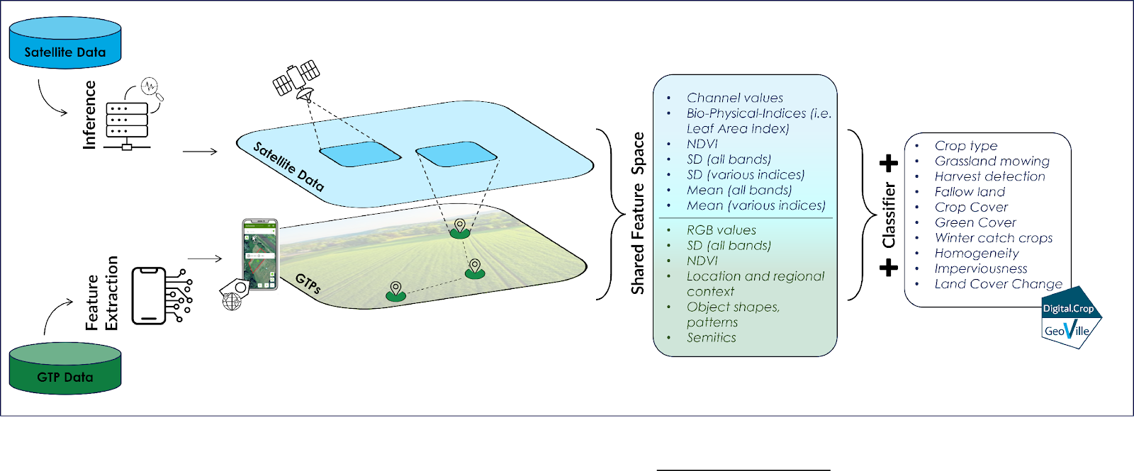
Methodological Advantages
Satellite Data: Consistency, objectivity, scalability
Geo-Tagged Photos: precise, accurate ground truth

Slide 6
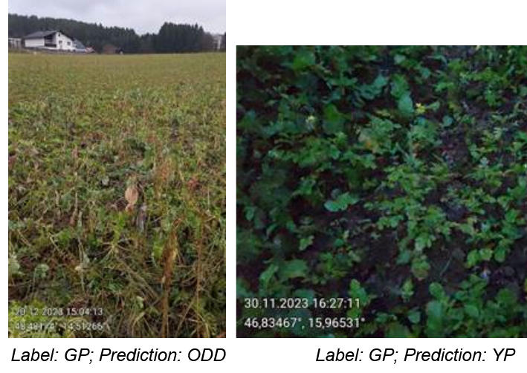
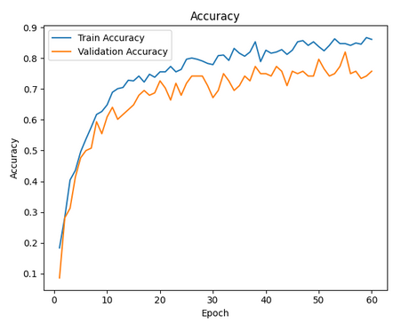
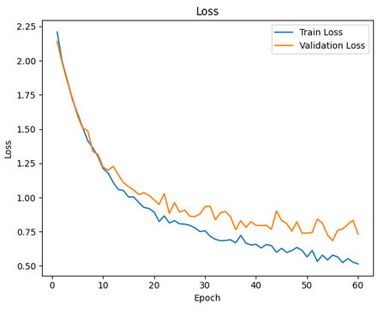
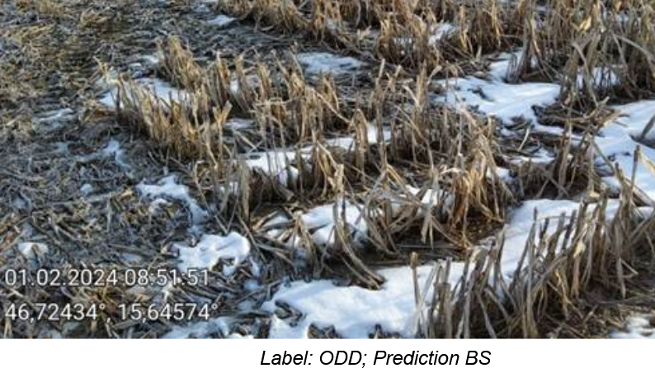
Classification of crop status & event on GTPs
Quality filter of GTPs
Identification
of the parcel on the GTP
Classification of the status or event
Creating labels = ML input data
Feedback to AMA to guide how to take GTPs
Filtering based on parameters: traning and parametrizing ResNet18 neural network model
Approximately two-thirds of parcels with GTP series are confidently classified and do not require further human validation!
For AMS needs a detailed breakdown of vegetation states and soil conditions
Bare Soil (BS)
Young Plants (YP)
Grown Plants (GP)
Old, Dry or Dead Plants (ODD)
Plants under Snow
Not Agricultural
PG of Flower-bearing/non-flowering for NCS
Other/Unclear
Train accuracy peaked above 85%, with validation accuracy of 75–78%.
Loss curves indicate healthy convergence, with steady improvement and minimal overfitting.

Slide 7
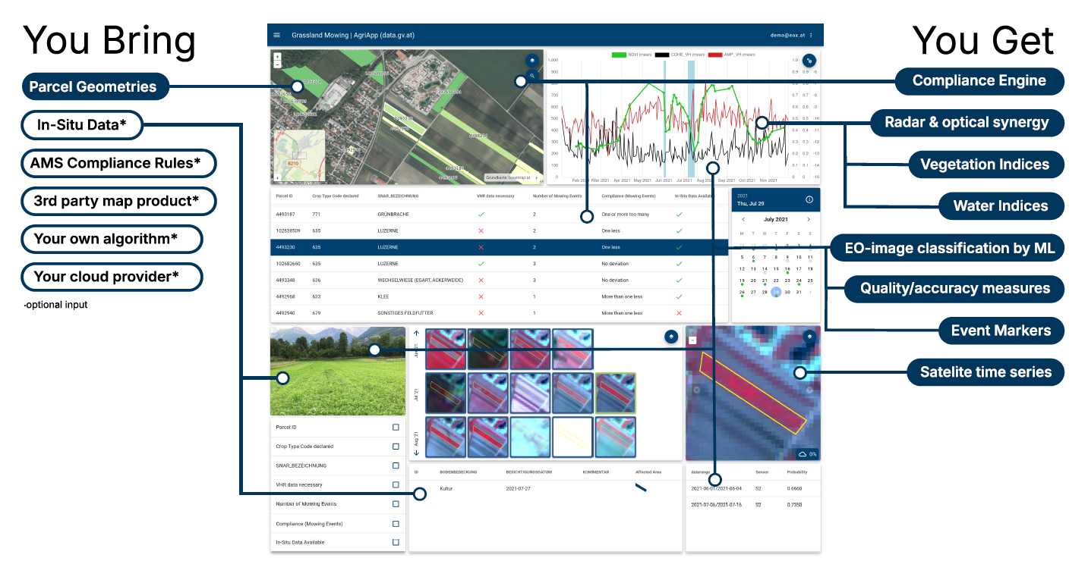

AgriApp – insight to AMS products
Public demo is at:
https://agri.demo.hub.eox.at/crop_type_classification/parcelexplorer?zoom=15.01

Slide 8
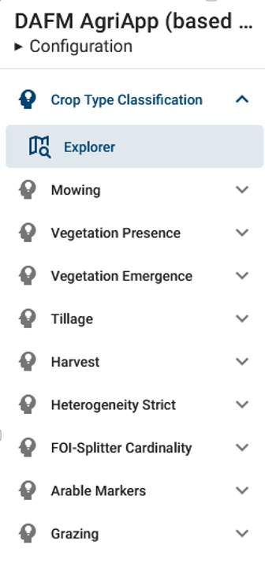
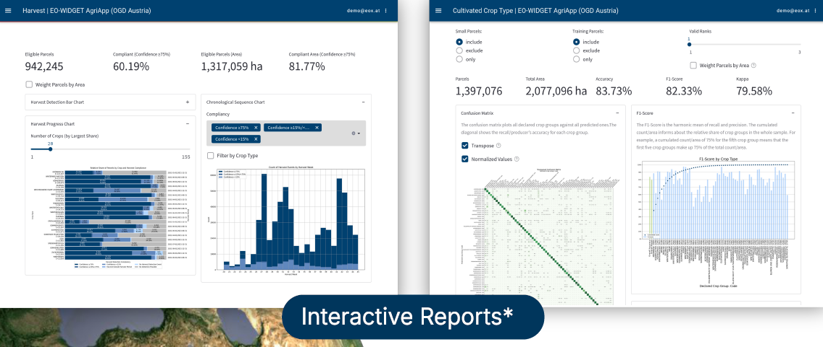
AgriApp – Dashboard service for decisiosn-making
based on satellite and in-situ data
Cloud based EO data processing, ML products and markers AMS rule engine - as open value chain
Value-added information
Interactive querries, data validation and reporting: accuracy measures

Slide 9

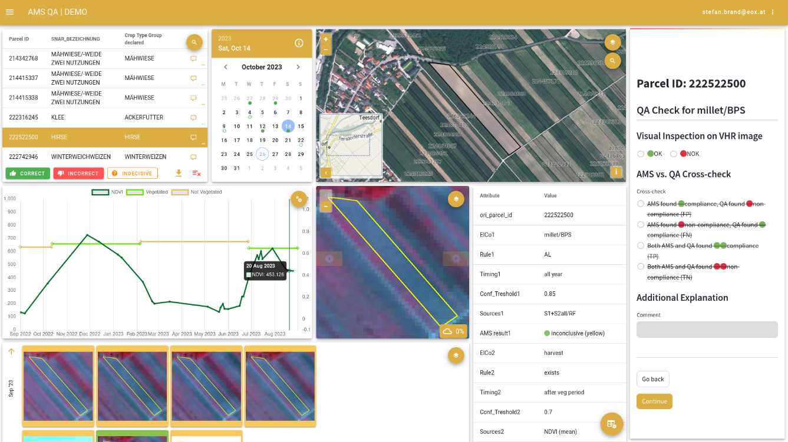
Dedicated AMS/QA frontend
Independent evaluation of AMS result based on the EC/JRC guidance
- chart widget shows the signal profiles / event detection
- actual VHR + any ortho-img are in the map view
- all available EO data are in the Image chips for CAPI

Slide 10

Empowering Nature-Positive Transformation
We believe that nature must be an integral part of our everyday (economic) decision-making process.
Our aim is to create a “market” for natural capital - making conservation finance easily accessible to people or entities that are keen to build a “grandchild-friendly” future and a new normal.
How? We support the preservation and restoration of local ecosystems in Europe by implementing scalable valuation methodologies for Sustainable Ecosystem Management & Financing.
Expanding beyond carbon: Measurement, reporting and verification for biodiversity monetisation
-- 75% of euro area corporate loans depend on ecosystem services…

Slide 11
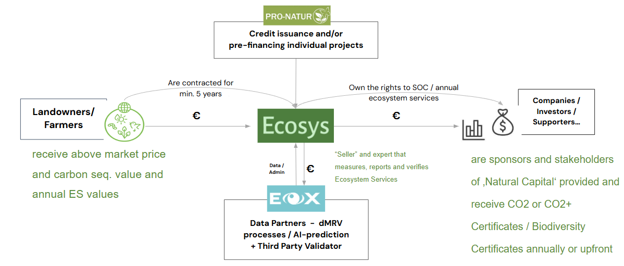
NCS: Natural Capital Solutions Platform

Slide 12
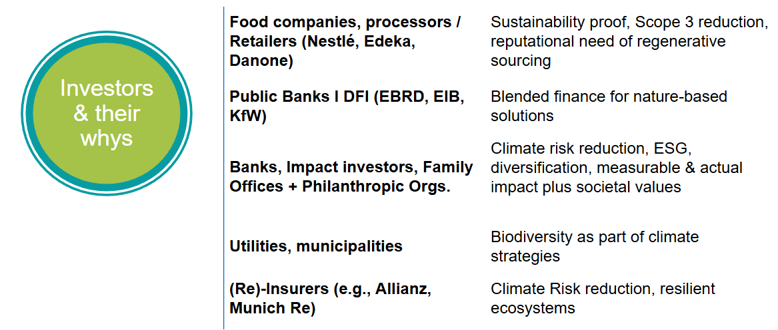
Who is interested in “buying”/supporting nature value?

Slide 13
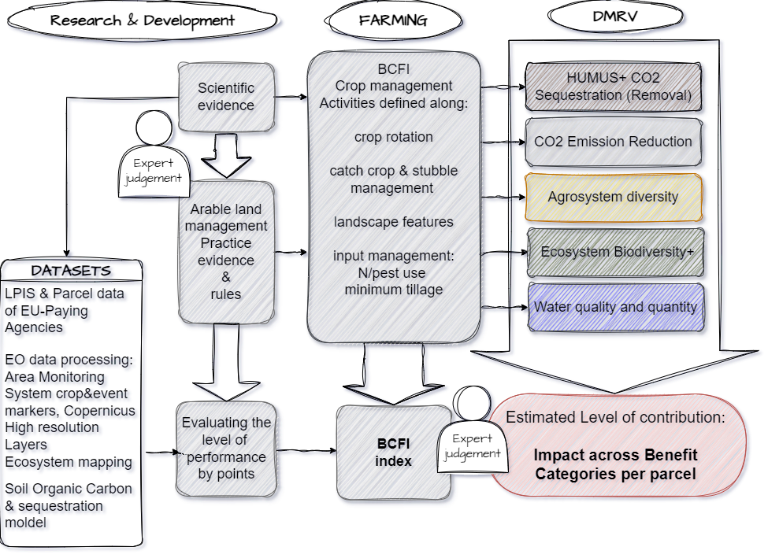
Ecosystemn Indicators
Science-backed Assumptions
Biodoversity Carbon farming Index:
Soil organic carbon stock + annual sequestration capacity,
Crop management practices
CO2 sequestration potential and oxygen production
Fresh Water filtration capacity, buffering against N-leakage
Biodiversity: habitat connectivity: edge length & ecosystem distance and agro-diversity: management activities, species richness and rotational effects

Slide 14
Concepts of AMS data use beyond the annual payment validation
Ex-post evaluation
Predictive modelling
Indicators, Scenarios
EO-validated annual, parcel level, marker-based categories
EO-signal products = Analyses Ready Data
- presents the IACS-ElCo rules by lanes,
- fixed categories,
- fixed tresholds,
- fixed combinations of markers, periodically
- only for the selected parcels,
- made by contractors archived by PA’s
LPIS Land cover + GSA
- vegetation indexes
- optical-radar synergy?
- pixel - object level?
- full country scale?
- continuous all year?
- classifications, ML inputs /outputs?
- data is only at AMS contractors ?
- rotationally/annually validated on VHR,
- wall-to-wall LPIS/LCC concept?
- classes by CAP/ElCos
- phenology-based LCC
External 3rd party datasets
gap filling: Copernicus HRLs as LCC out of LPIS or Planet Fusion
new info: soil properties, SOC, drought, waterlog
increase of open data

Slide 15
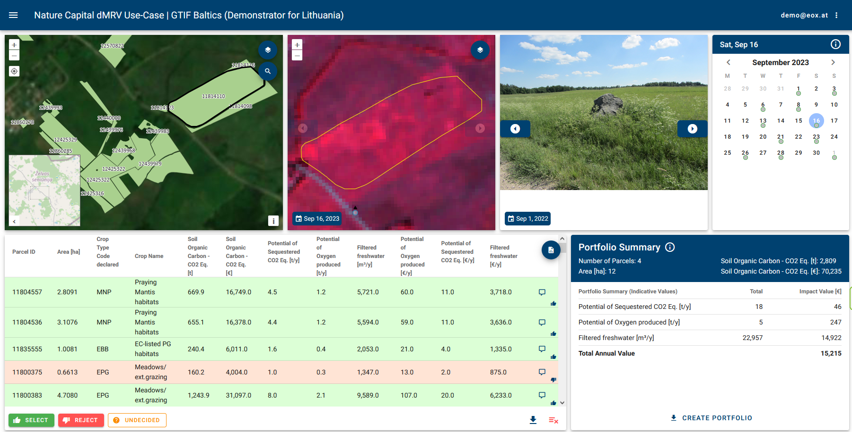
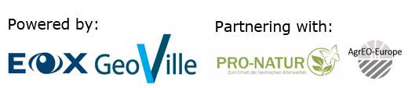
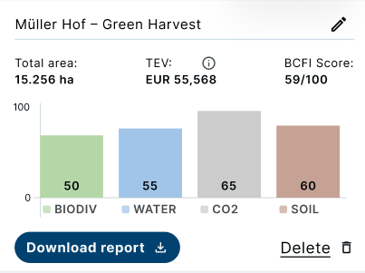

Nature Analytics, dMRV & Portfolio Selection Tool
(Demonstrator HNV Grassland)
https://eox-ncs.gtif.eox.at/nature-capital/parcelexplorer?zoom=15.01&parcel=11878716&date=2023-08-07
Clear Monitoring Framework including validated data points (statistical plus in-situ) & verification methodology
Integration with Decision-Making
Scalability & Standardization

Slide 16

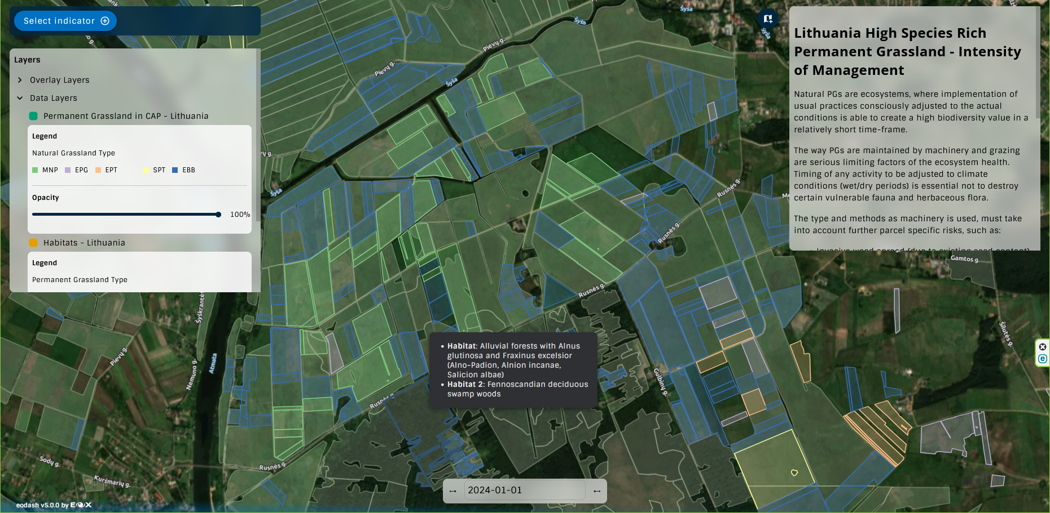
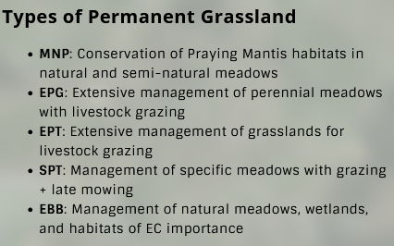

GREEN TRANSITION INFORMATION FACTORIES– KICK-STARTERS Funded by ESA
Lithuanian use case of Natural Capital Solutions management
Dashboard to presenet Carbon & Biodiversity accounting
Dashboard Development had just started, stakeholder engagement is
on-going.
https://baltic-gtif.github.io/baltic-client/explore/?x=21.5049&y=55.3669&z=12.1442&date[…]024-01-01&template=expert&indicator=grassland_intensity_lt

Slide 17
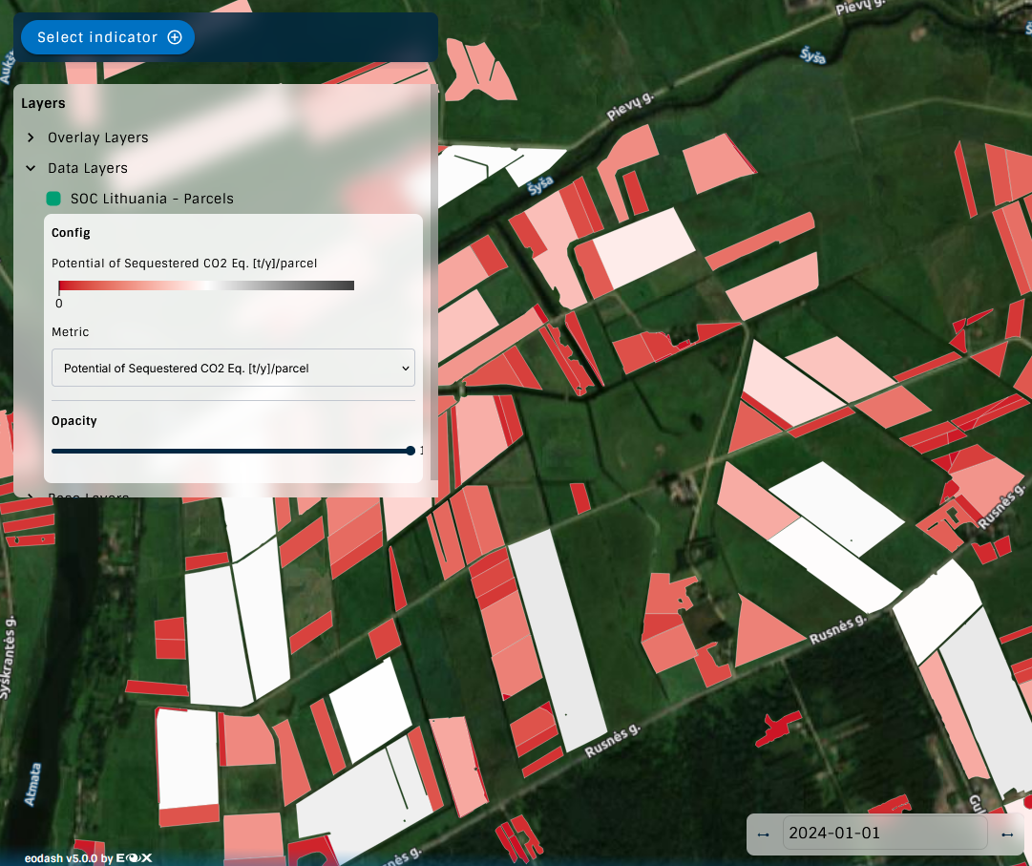
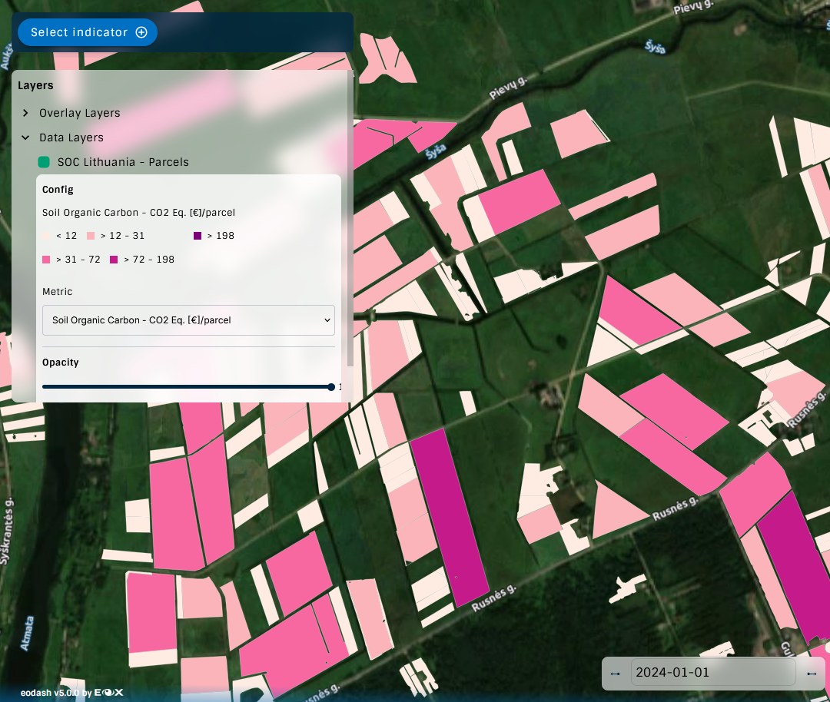
GREEN TRANSITION INFORMATION FACTORIES– KICK-STARTERS Funded by ESA
Lithuanian use case of Natural Capital Solutions management
Dashboard to presenet Carbon & Biodiversity accounting

Slide 18
GREEN TRANSITION INFORMATION FACTORIES– KICK-STARTERS Funded by ESA
Further Lithuanian thematic use cases are under development:
Comparing SOC content and estimated annual potential sequestration values calculated on parcel level by various dels and sources:
For example: GHG Monitoring Database And Carbon Register of Gfarm project and the GloSIS, the Global Soil Information System of the FAO
Visualising the conversion of permanent grassland to arable land parcels based on the change in the GSA from y2024 to y2025 presenting the ecosystem type and SOC value in danger
Ecosystem connectivity index – on parcel level, based on avaiable LULC data

Slide 19

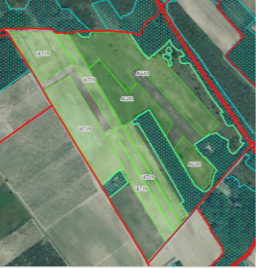
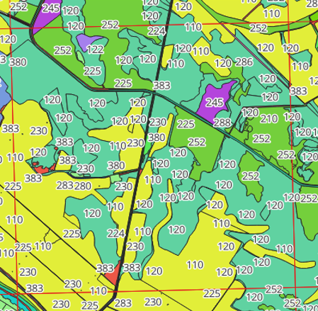
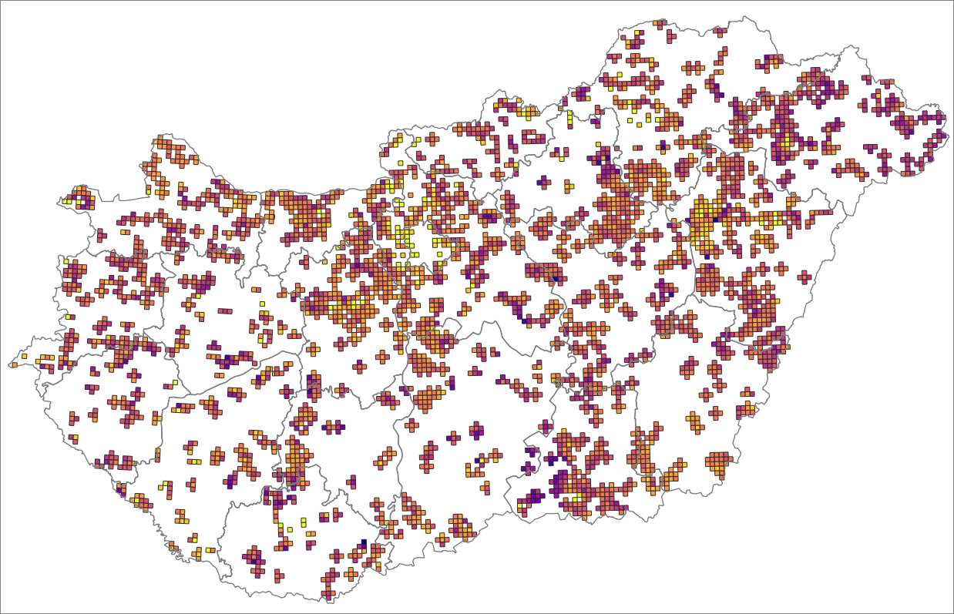
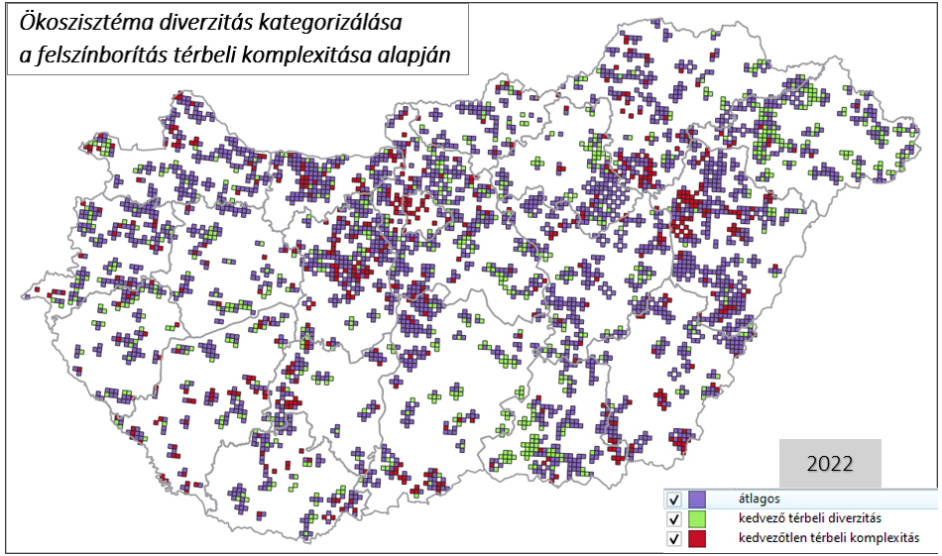
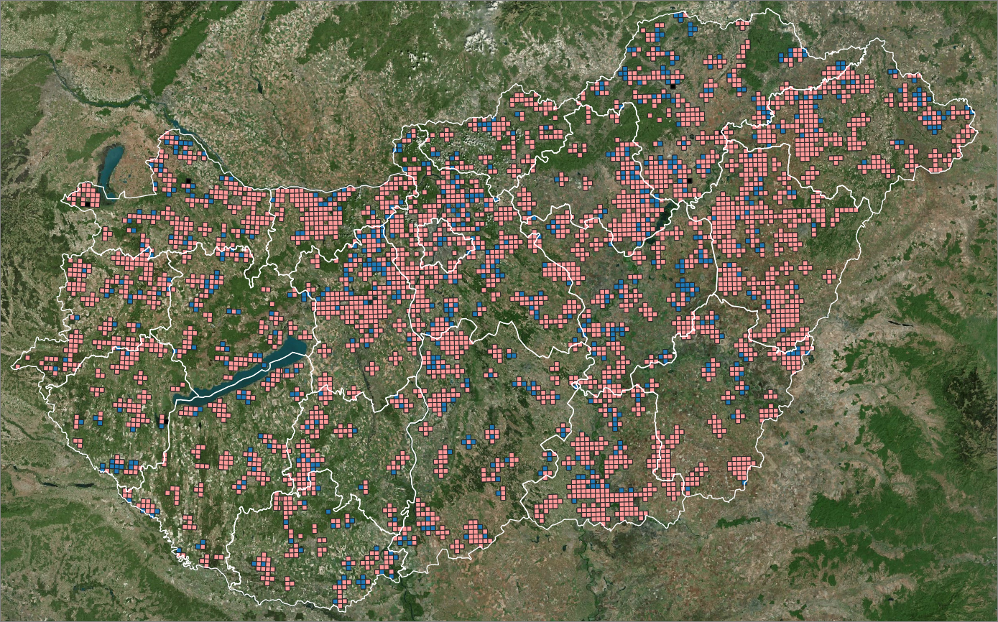

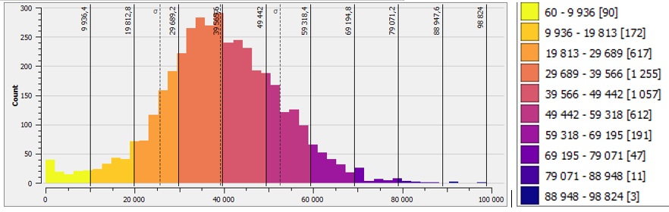



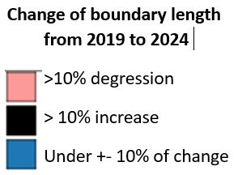


Ecosystem connectivity index – Hungarian example
Hungarian use case for ex-post and ex-ante evaluation of Rural Development measures:
Ecological network around the CAP parcels: calculating spatial connectivity, variability and complexity
EO-based LCC data of LPIS from 2013-2024
Key point: wall-to-wall physical blocks geom !
Creating LCC groups by ecosystem function, intensity of use: herbaceous / arboreal dominant, water-det …
Calculating per kvadrat/year : sum of
- all edge lengths,
- arable and natural + semi nat. habitats,
- arable land + LFs.
Calculating difference of 5 years, trendlines per quadrat, >10%< change + Categorising the status as: average, over and under ave.
Sum length of adjancent agricultural and natural+semi-natural areas per quadrat
– year 2024
Categorising ecosystem diversity by spatial LCC complexity
Source:https:https://www.researchgate.net/publication/341399262_Fine-tuning_of_the_LPIS_philosophy_and_methodology
Authors: Bernadett Csonka, László Podmaniczky, Julianna Skutai, Péter Tóth
Partners:

Slide 20
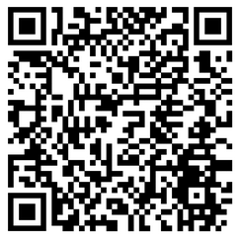


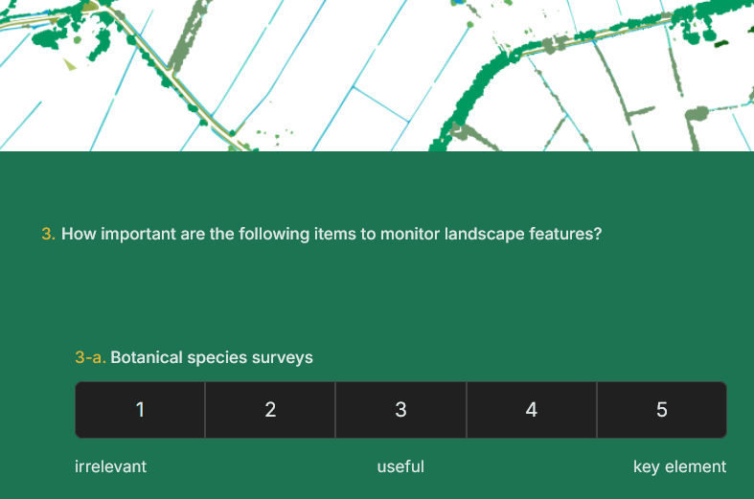
… to act together for biodiversity,
Landscape Feature mapping
participate on our questionary:
https://mnmy9cu8.forms.app/landscape-features-biodiversity-europe
With advances in Remote Sensing and AI technologies, we can now monitor the status of Landscape Features with increasing accuracy. The next step is to translate this monitoring power into real policy impact - and for that, collaboration is essential.

