Slide 1

Introduction of “AMS 2.0”: New Opportunities for Administering and Monitoring the Strategic Plan Measures
Aušrius Kučinskas
Head of Direct Payment Control Unit
Notes:
Pridėti atsiperkamumą, pagrindinė žinutė kokia nauda, realios iliustracijos iš lauko su problematika

Slide 2

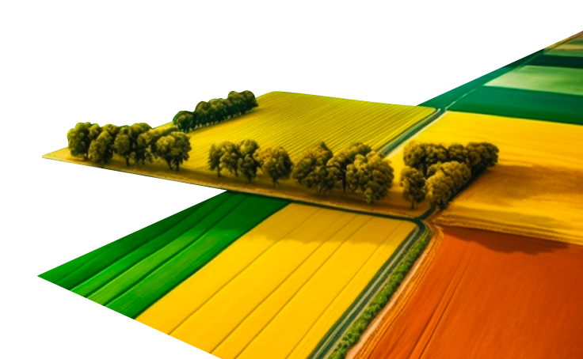
Why We Started the Project
EU Regulation (EU) 2021/2116 requires modern CAP monitoring
  Requires extensive use of AMS, with a gradual increase of monitored interventions (Art. 75(b))
Need to reduce manual inspections & ensure fair subsidies
  Satellite-based checks lower administrative costs and prevent unfair claims
Build resilience to climate change impacts
  Monitoring drought, flooding, and soil degradation supports adaptation strategies
Leverage Sentinel satellite expertise for reliable monitoring
  Years of experience with Copernicus data allow advanced markers development
Provide farmers with new data layers for better decision-making
  Tools like crop quality, soil moisture, and yield zones guide smarter farm practices
Notes:
project will modernise the Integrated Agricultural Administration and Control System (ŽŪPAIS) by increasing data scope and quality, improving result frequency and service range, and providing greater data access to farmers, institutions, policymakers, and the public.
Pridėti 12 naujų algoritmų nesusijusiu su AMS v1

Slide 3
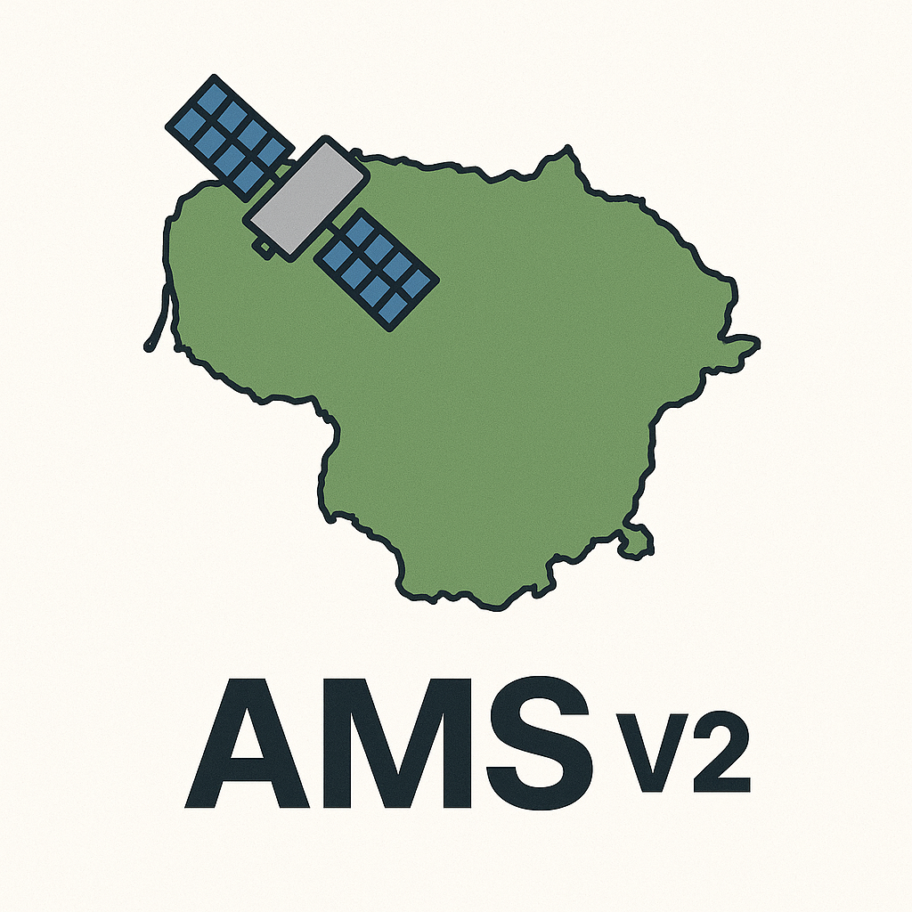
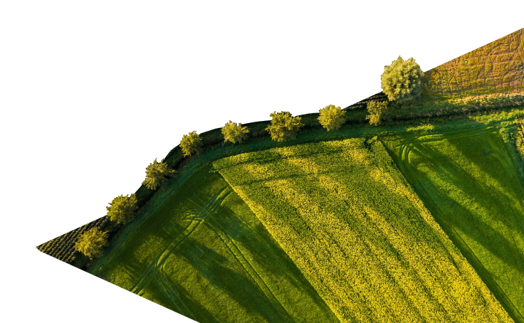
Modernisation of AMS by Developing New Markers
Start Date: 12 January 2024
End Date: 31 December 2025
Budget: €2,241,024.61 (Recovery and Resilience Facility (RRF))
Goal:
Improve data scope, quality, and update frequency
Expand services for farmers, institutions, and policymakers
Increase transparency and access to agricultural monitoring data
Massive Return on Investment
Total creation & maintenance (10y): ~3.5M EUR
Total 10-year savings: ~967M EUR
Net benefit: ~963M EUR (≈27x return)
Notes:
project will modernise the Integrated Agricultural Administration and Control System (ŽŪPAIS) by increasing data scope and quality, improving result frequency and service range, and providing greater data access to farmers, institutions, policymakers, and the public.
Pridėti 12 naujų algoritmų nesusijusiu su AMS v1

Slide 4
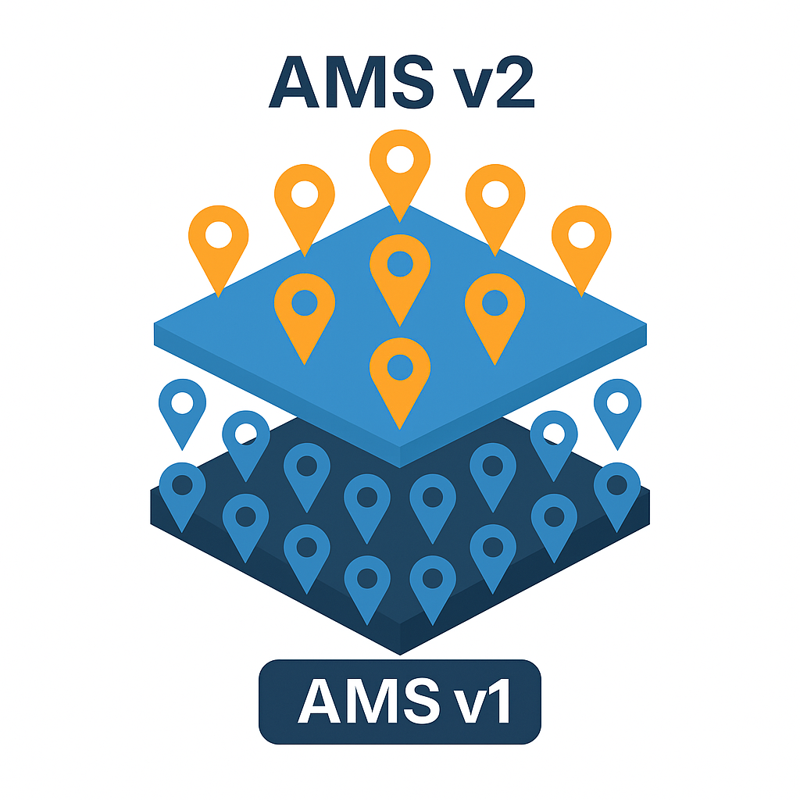
AMSv1 and AMSv2
AMS v1 - 7 markers
  Arable land
  Grasslands
  Permanent crops
  Non elegible objects
  Grasland mowing
  Black follow land
  17 crops
AMS v2 - 12 markers
  Group 1 – AMS use
  Land Cover Automatic Classification
  Automatic Field Boundary Delineation
  Early Crop Classification
  Organic Farming Verification
  Stubble Detection
  Crop Heterogeneity Detection
  Group 2 – All users use
  Crop Quality Assessment
  Yield Zone Identification
  Storm Damage
  Soil Erosion
  Soil Moisture
  Soil Organic Carbon

Slide 5
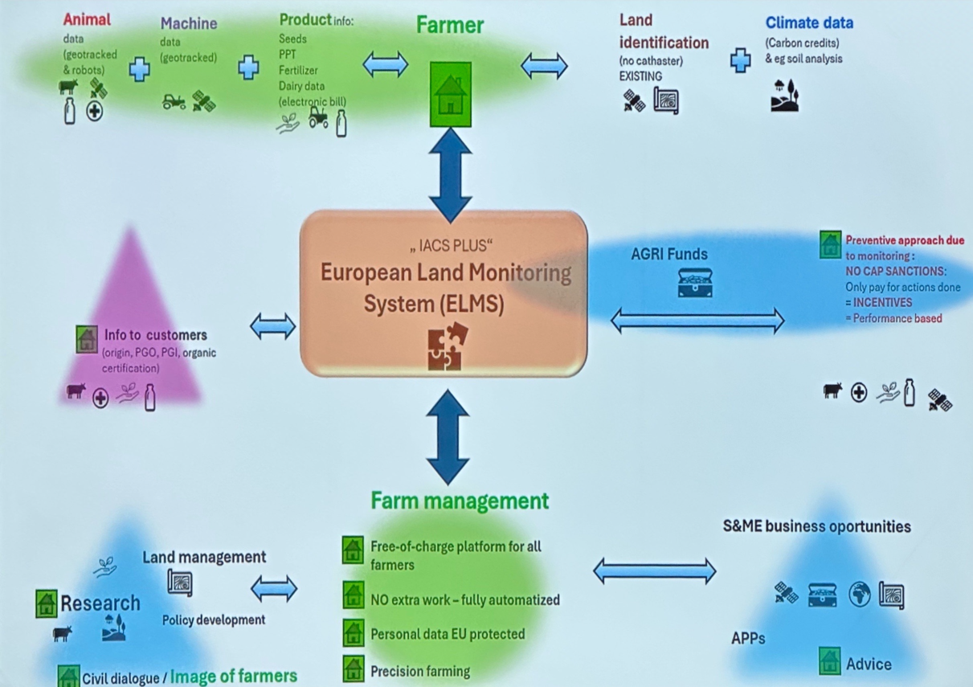

Insights: IACS PLUS & AMS v2 Alignment
IACS PLUS – Next-Gen EU Land Monitoring
Future Concept
  Integrated, cross-border data
  Smarter compliance checks
AMS v2 Link
  Shared architecture & standards
  Supports remote sensing & change detection
Strategic Benefits
  Easy migration to IACS PLUS
  Future-proof for CAP & funding rules
  Boosts transparency & efficiency

Slide 6
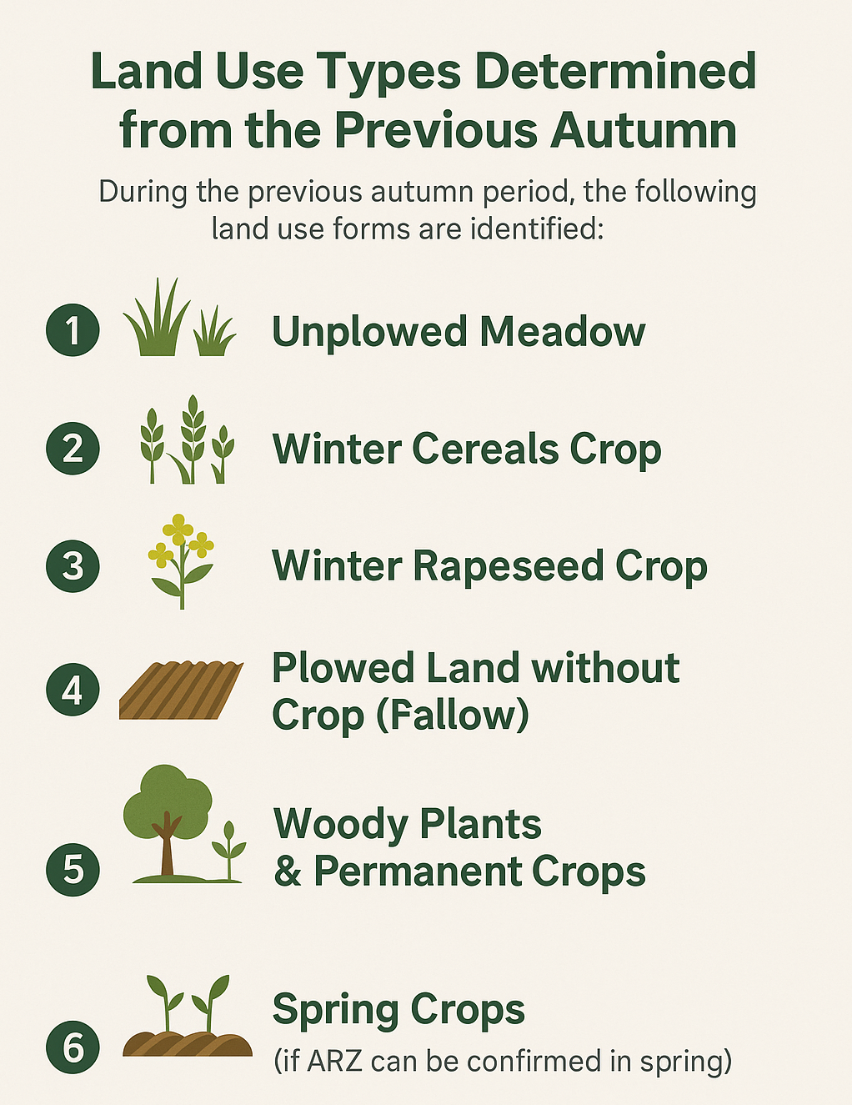
Early Crop Classification
Methodology & Purpose
  Early-season classification (autumn/winter) with Sentinel data to infer land use (winter cereals, grass, fallow)
  Provides preliminary crop map before official declarations
Practical Use
  Early detection of discrepancies
  Supports CAP campaign planning and crop-support forecasts
Result
  Preliminary parcel-level seasonal land-use layer
Notes:
Alnsis

Slide 7
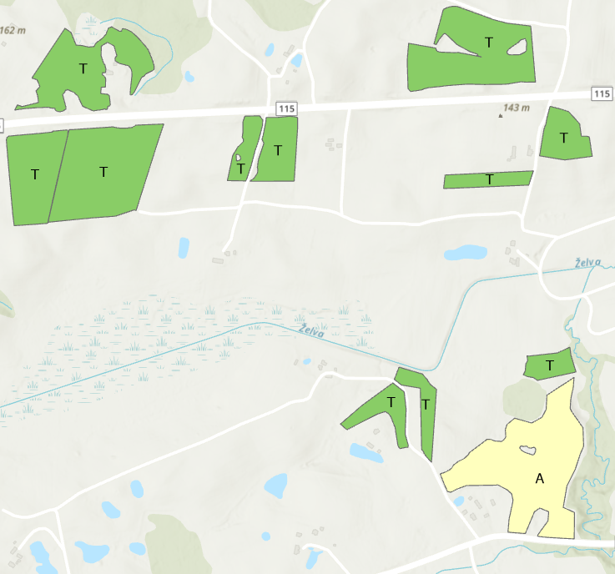
Organic Farming Verification
Methodology & Purpose
  Analyze Sentinel-1 time series to check if declared organic fields show expected vegetation patterns (slower early growth, higher biodiversity)
  Provide satellite-based validation of organic farming declarations under CAP eco-schemes
Practical Use
  Strengthens trust in subsidy distribution
  Reduces misdeclaration risk
  Supports inspectors in targeting and verification
Result
  Compliance map with organic match status (True / No / Ambiguous)
Notes:
Alnsis

Slide 8
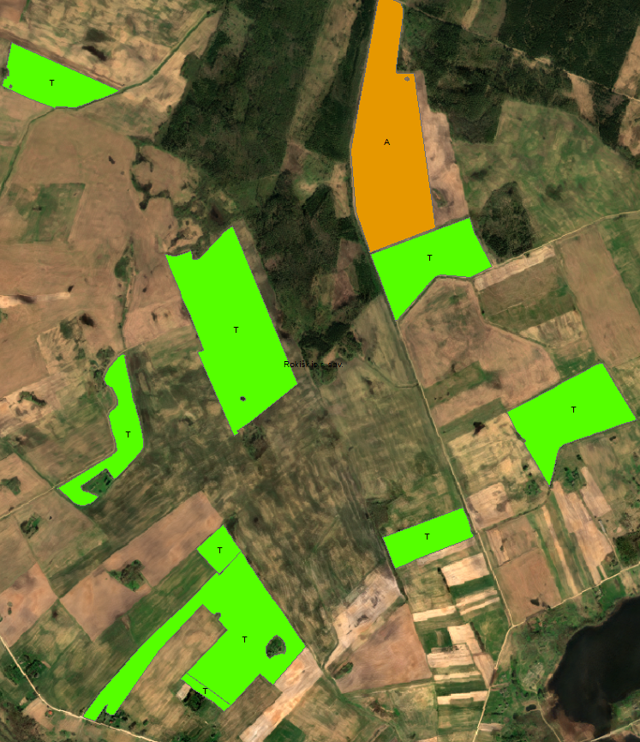
Stubble Detection and Monitoring
Methodology & Purpose
  Use Sentinel-1 radar reflectivity and vegetation index drop to detect stubble after harvest
  Verify no-till / low-disturbance compliance by 31 Oct deadline
Practical Use
  Supports environmental audits & CAP greening checks
  Prevents penalties from incorrect land management
Result
  Field classes: Stubble Present / Absent / Uncertain (T/N/A)
  Checked 80 fields → 17 violations, 13 OK, 4 uncertain
Notes:
Alnsis

Slide 9
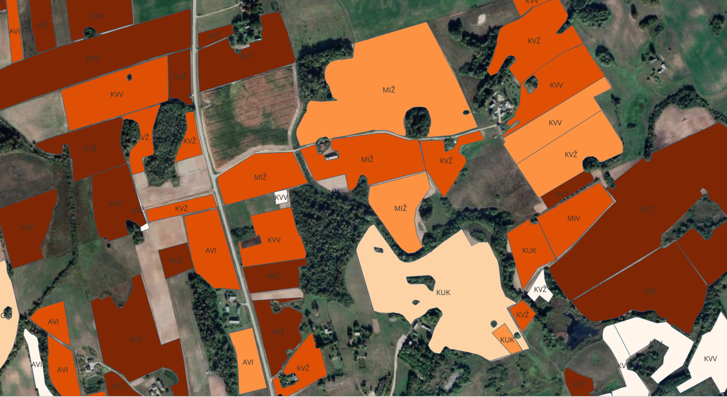
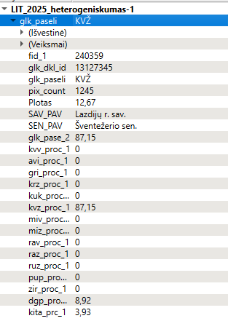
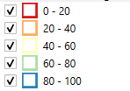
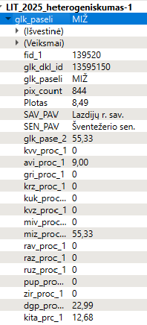
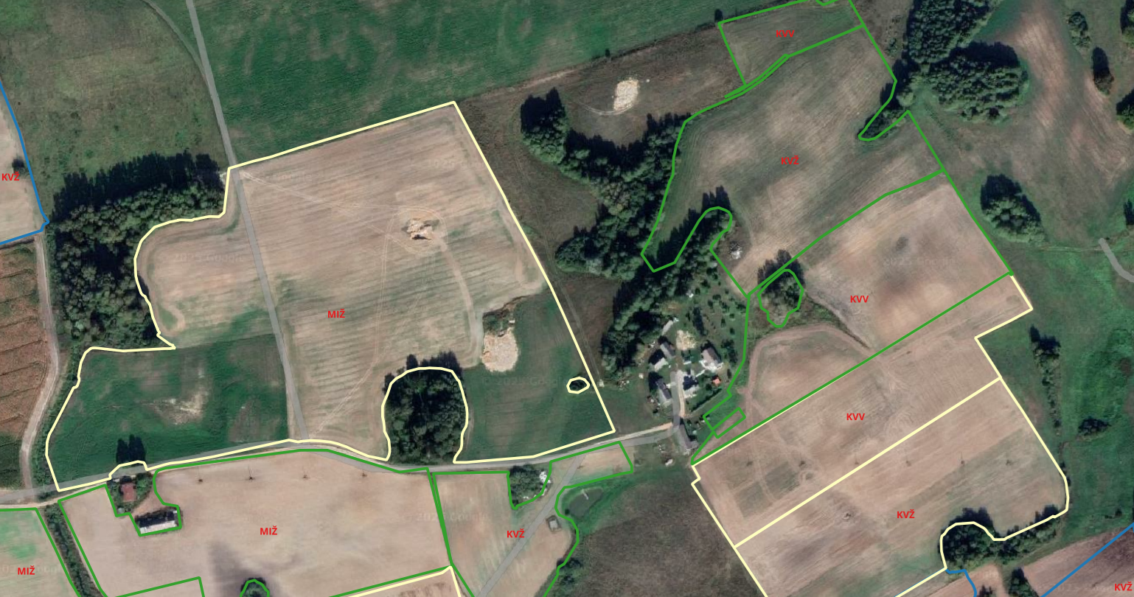
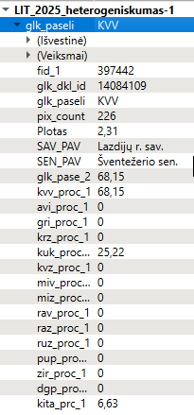
Crop Heterogeneity Detection
Methodology & Purpose
  Analyze spatial variance of vegetation & backscatter to classify in-field crop uniformity
  Detect anomalies: poor sowing, weed clusters, nutrient issues
Practical Use
  Supports precision agriculture (variable fertilization, targeted treatments)
  Validates accuracy of field declarations
Result
  Zonal uniformity map per parcel
  3,110 fields checked (2025 inspections)
  2,547 positive (81.9 %) → strong marker reliability
Notes:
Alnsis

Slide 10
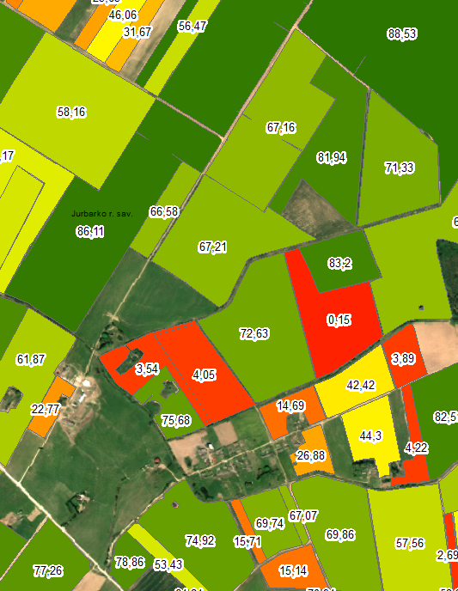
Crop Quality Assessment
Methodology & Purpose
  Use radar & spectral pixel-based classification to map crop-condition probability zones (good / average / poor)
  Build a Crop Quality Index (CQI) by comparing NDVI, backscatter, and other metrics with reference years & neighboring fields
Practical Use
  Detect underperforming zones from drought, over-fertilization, or pests
  Enable early intervention, adaptive fertilization, and targeted support
  Supports parcel-level quality benchmarking and season-to-season comparisons
Result
  CQI-coded vector layer for every declared field
Notes:
Alnsis

Slide 11
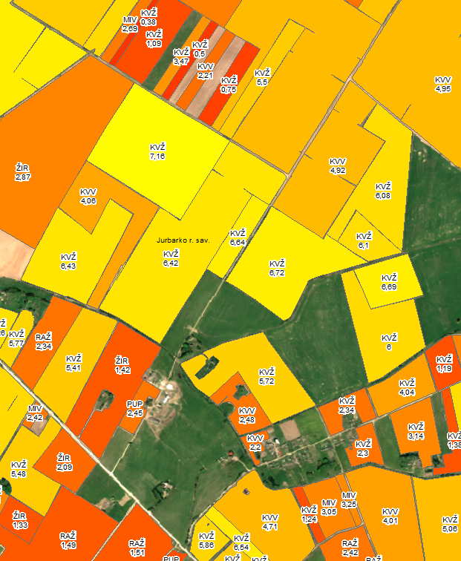
Yield Zone Identification & Forecasting
Methodology & Purpose
  Use radar & spectral pixel-based classification plus statistical yield data per crop type
  Analyze vegetation dynamics & growth trends to forecast yield and identify productivity zones
  Model spatial and temporal crop yield potential, highlighting intra-field variability and harvest volume
Practical Use
  Supports logistic planning (harvest equipment, scheduling)
  Informs pricing strategies
  Ensures environmental compliance tied to yield efficiency
Result
  Zonal yield maps with expected productivity ratings
  Provide parcel-level forecasts for harvest and resource allocation
Notes:
Alnsis

Slide 12
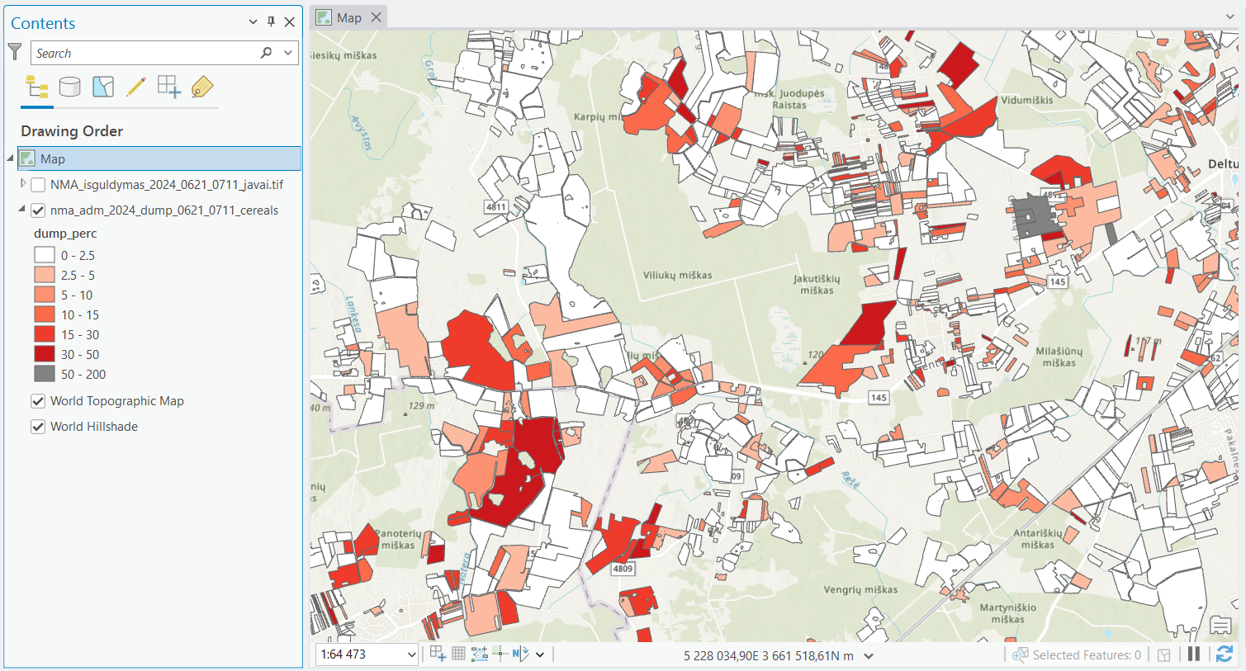
Crop Lodging Detection (Storm Damage)
Methodology & Purpose
  Use Sentinel-1 radar polarimetry to detect physical crop flattening from wind or excess nitrogen
  Automatically map and quantify crop lodging events for rapid response and loss estimation
Practical Use
  Enables objective storm-damage reporting for insurance
  Reduces need for manual field inspections
  Supports CAP emergency-aid assessments
Result
  Vector dataset of lodged zones per field with estimated impact
  Reliability: ~70 %
Notes:
Alnsis

Slide 13
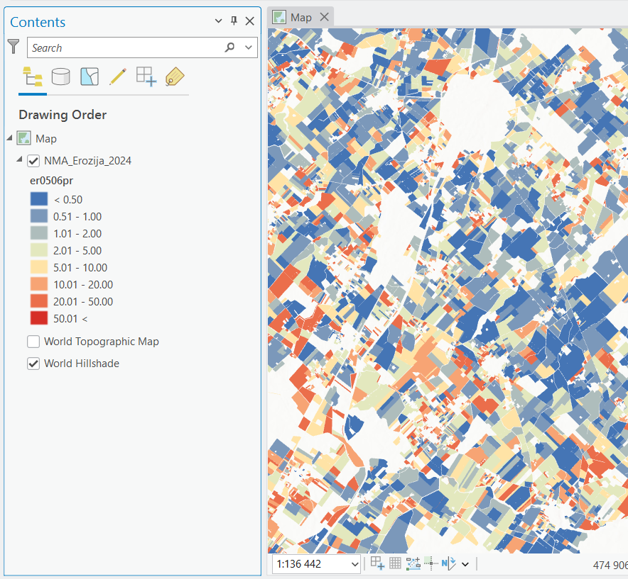
Soil Erosion Risk Mapping
Methodology & Purpose
  Use Sentinel 1 time-series analysis to detect recurring bare soil or weak vegetation
  Map erosion-prone areas and long-term soil-loss risk
Practical Use
  Supports CAP soil-conservation measures
  Guides cover-crop and management decisions
  Informs regional land-use planning
Result
  Erosion-risk maps with intensity levels per plot
  Reliability: ~68 %
Notes:
Alnsis

Slide 14
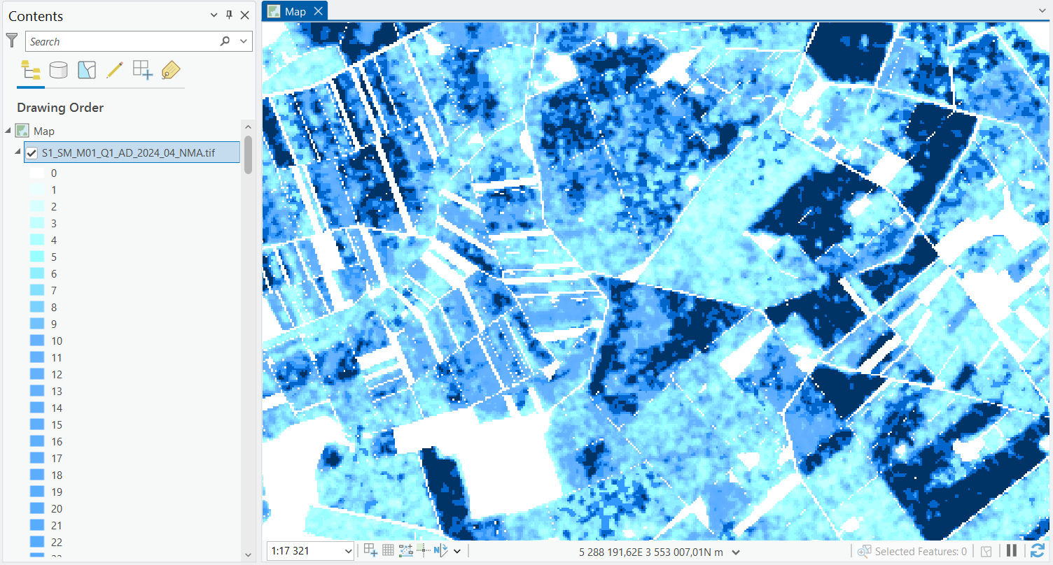
Soil Moisture Intensity Mapping
Methodology & Purpose
  Use Sentinel-1 radar to classify fields into dry / medium / wet zones based on dielectric soil-moisture response
  Monitor temporal and spatial changes in soil water content during the growing season
Practical Use
  Guide irrigation planning and sowing schedules
  Inform drainage management and machinery access in wet/dry periods
Result
  Moisture-classification layers with in-field gradients
  Reliability: ~74 %
Notes:
Alnsis

Slide 15
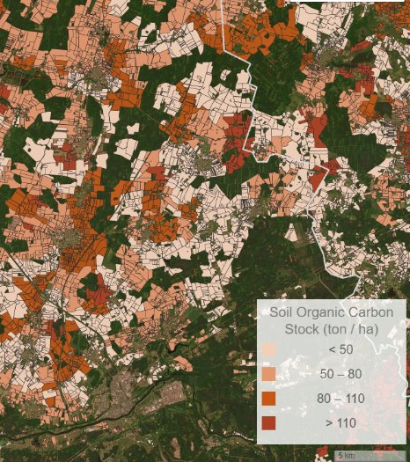
Soil Organic Carbon Classification
Methodology & Purpose
  Estimate and classify soil organic carbon (SOC, 0–30 cm) using Sentinel-2 imagery combined with LUCAS soil samples
  Assess carbon storage potential and locate areas for carbon farming and sequestration programs
Practical Use
  Supports carbon-credit schemes and national CO₂ inventories
  Promotes sustainable soil management for long-term fertility
Result
  SOC-classified vector layers for farmland
Notes:
Alnsis

Slide 16

Next Steps
Complete validation of project outputs
Publish results as open data
  NPA portal
  NMA agro mobile geotag app
  LT open data portal
Large AMS 2.0 dissemination campaign
  External PR company for dissemination strategy
  Present findings at conferences and stakeholder workshops
  Publish articles, newsletters, and social media updates
Prepare for five years of post-project support
  Ensure maintenance, updates, and stakeholder engagement

Slide 17








Thank you for Your attention
National Paying Agency under the Ministry of Agriculture
  Blindžių Str. 17, 08111 Vilnius
  +370 (5) 252 6999
  info@nma.lt
www.nma.lt

