Slide 1

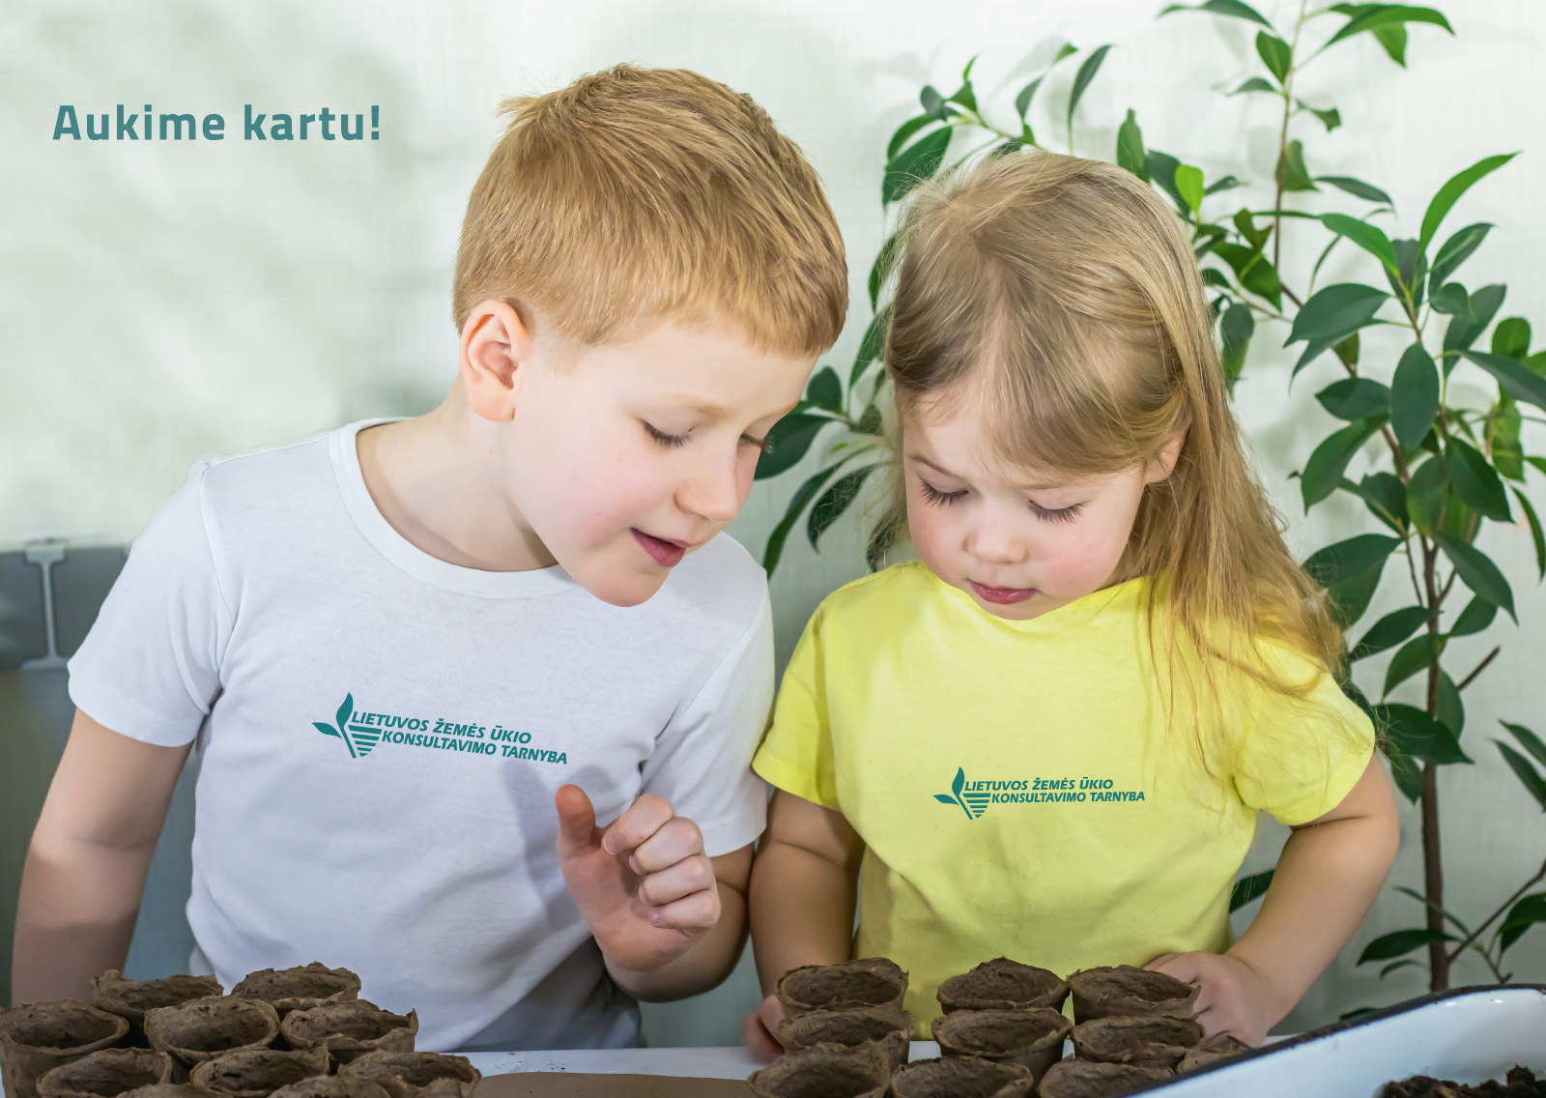
The Contribution of International Projects to Agricultural Innovations and Implementation
Rimtautas Petraitis, Deputy Director, Lithuanian Agricultural Advisory Service (LAAS)
Vilnius, 2025-09-26
Notes:
In my presentation, I will focus on the role of international projects in fostering innovation – because in today’s agriculture, innovation is not created in isolation. It is the result of cross-border cooperation, shared knowledge, and collective effort.
At the Lithuanian Agricultural Advisory Service – or LAAS – we have extensive experience in participating in such projects. I will share how these projects support farmers, advisors, and policy-makers, and why international cooperation is important for sustainable and competitive farming.

Slide 2
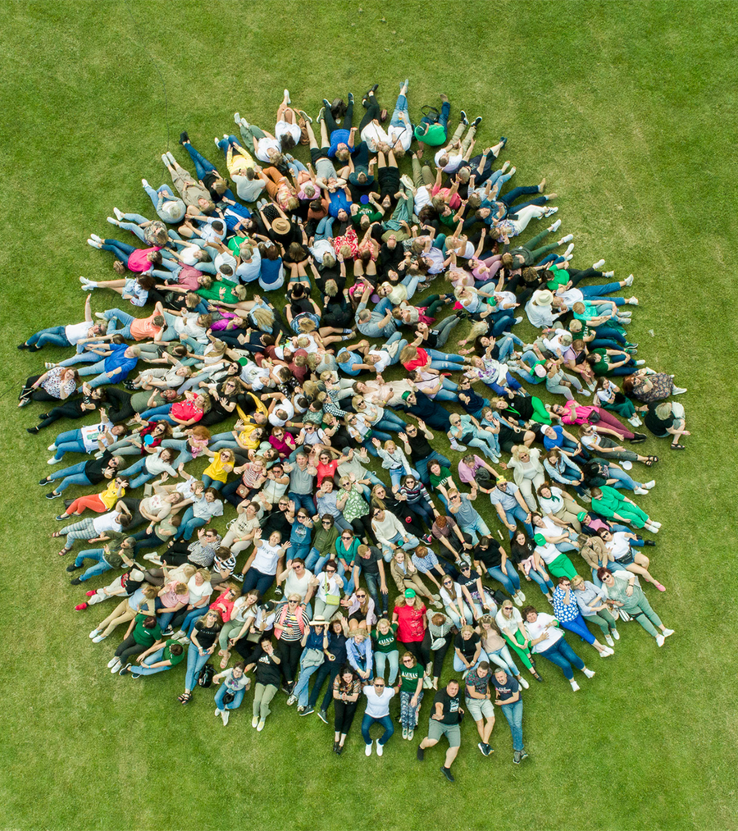
Lithuanian Agricultural Advisory Service (LAAS)
400 professional staff
44 advisory offices
8 service groups
10 thou clients, of which – 7 thou contract clients
97 % of customers recommend services to others
06
Notes:
But before I go into projects, let me briefly introduce our organization.
LAAS was founded in 1993. Today, LAAS has grown into a strong advisory organization – with 400 professional staff, 44 advisory offices, and around 10,000 clients. Of those, 7,000 are long-term contract clients. We are proud that 97% of our customers recommend our services to others, which shows the trust we have built over the years.

Slide 3
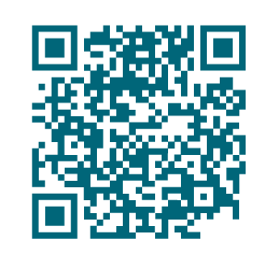
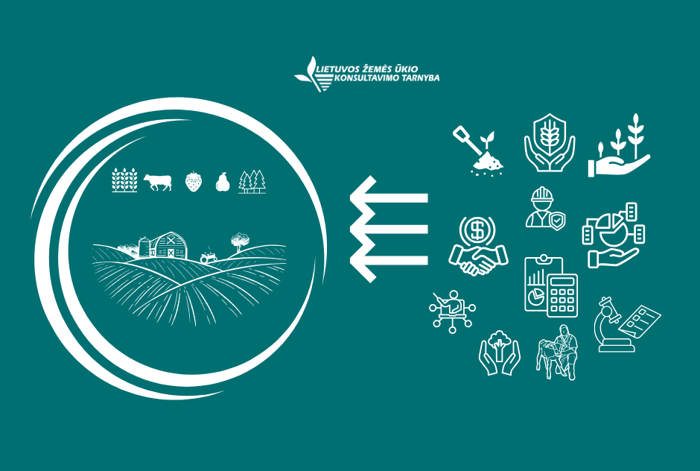
Range of services
Accounting
Business economics
Crop production
Animal husbandry
Forestry
Occupational safety
Laboratory testing
Training (in-person / online)
06

Slide 4
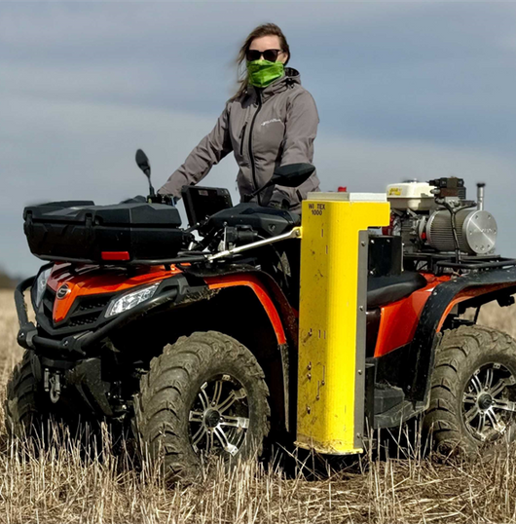
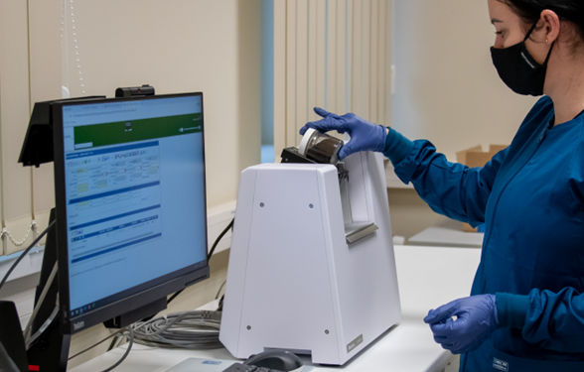
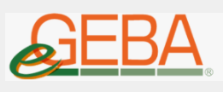

Innovative tools and services
    Centre of Precision Farming Services and Competencies
    Accredited Water and Soil Testing Laboratory
    Digital tools: IKMIS, eGeba
07

Slide 5
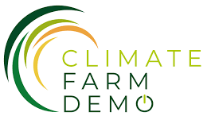
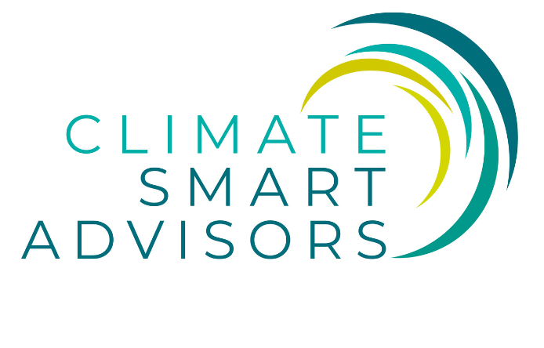

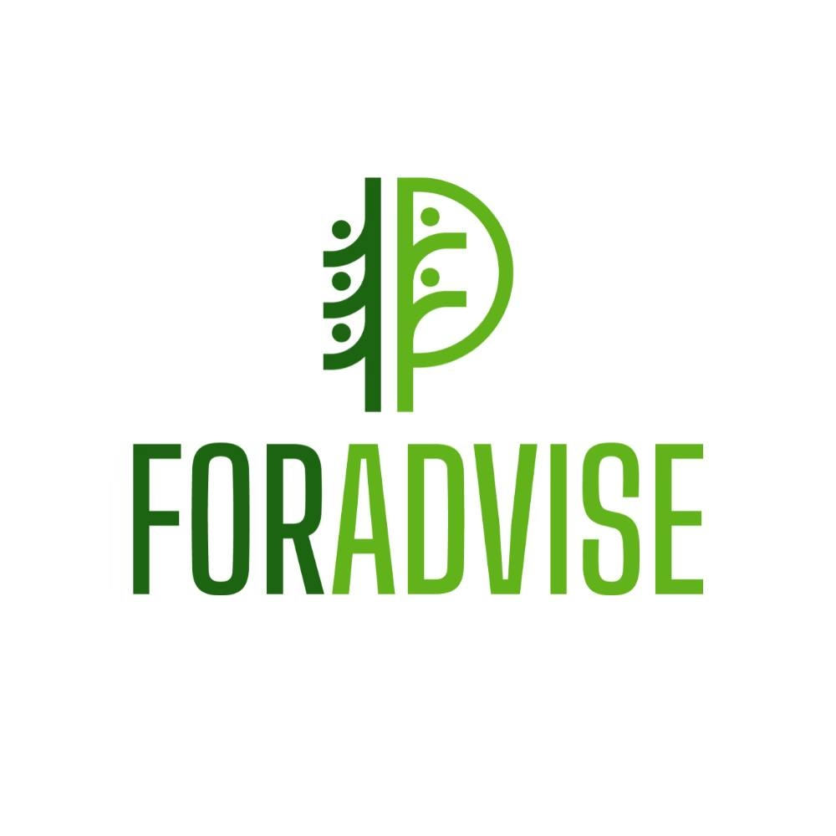


Projects’ portfolio of LAAS
15 ongoing projects, including 6 international (Horizon 2020 / Horizon Europe).
Main themes: climate-smart agriculture, sustainable forestry, strengthening advisors‘ competencies, developing digital tools.
06
Notes:
Currently, our organization is implementing 15 projects – 6 international and 9 national.
The international projects are mainly funded through the Horizon 2020 and Horizon Europe programmes. These projects focus on some of today’s most pressing agricultural and rural issues:
Climate-smart agriculture – improving soil health, sustainable water use, pesticide risk management.
Forestry – developing climate-smart and sustainable forestry practices.
Advisory services – strengthening advisors’ competencies and skills.
Digital tools – creating platforms and instruments to support farmers with data-driven solutions.
By participating in these international projects, we not only bring European knowledge to Lithuania but also share our national expertise with other countries.

Slide 6
Climate Farm Demo
„A European-wide Network of Pilot Farmers Implementing and Demonstrating Climate Smart Solutions for a Carbon Neutral Europe“ (2022–2029)
Objective: accelerate adoption of climate-smart practices on farm level.
Scope: EU-wide network of 1500 pilot farmers.
Impact: resilience to climate change, reduced green house gas (GHG) emissions.
Notes:
The “ClimateFarmDemo” project is one of our key international project, running from 2022 to 2029.
Its main idea is to build a Europe-wide network of 1,500 pilot farmers who demonstrate climate-smart solutions in practice.
The objective is to accelerate the adoption of climate-smart farming practices – making farms more resilient to climate change while reducing greenhouse gas emissions.
This project is not only valuable for farmers, but also for advisors – it creates opportunities to share experiences, learn from each other, and contribute to the common European goal of achieving carbon neutrality.

Slide 7
Climate Smart Advisors
“Connecting and Mobilizing the EU Agricultural Advisory Community to Support the Transition to Climate Smart Farming​​“ (2023–2030)
Objective: strengthen advisory capacity on climate-smart farming.
Scope: training advisors, sharing tools, cross-border learning.
Impact: better support for farmers to adopt climate-smart practice.
Notes:
This project – Climate Smart Advisors – is a Horizon Europe initiative running from 2023 to 2030.
Its aim is to connect and mobilize the agricultural advisory community across Europe to help farmers make the transition towards climate-smart farming.
The project strengthens the role of advisors, because they are the link between science, policy, and practice. By supporting advisors with knowledge, training, and networks, we can accelerate the uptake of climate-smart practices in farming.
For our organization, participation in this project means being part of a European-wide knowledge exchange, learning from other countries, and sharing our national expertise to improve advisory services and help farmers respond to climate change challenges.

Slide 8

Nutri-Check Net
“NUTRI-CHECK NETwork to Maximize Site-specific Precision in Managing the Nutrition of European Arable Crops“ (2023–2025)
Objective: improve precision of crop nutrition.
Scope: compiling decision-support tools, farm-by-farm nutrient checks.
Impact: better yields, reduced fertilizer use, lower environmental footprint.
Notes:
Nutri-Check Net is about improving the precision of crop nutrition. The project compiles decision-support tools that allow farmers to check nutrient requirements for each field individually. For farmers, this means higher yields, lower fertilizer costs, and reduced environmental footprint.
For advisors, the project provides access to new digital tools and methodologies, training opportunities, and a European network of colleagues. In short, the project delivers innovation both to farmers in practice and to advisors in their professional capacity.

Slide 9

FORADVISE
“European Advisory and Extension Networks on Forestry“ (2025–2029)
Objective: create European network of forest advisory organizations.
Scope: modernising advisory services, knowledge exchange.
Impact: sustainable forestry sector, aligned with European climate goals.
Notes:
FORADVISE is a European project that brings together advisory and extension organizations working in forestry. The aim is to modernize forest advisory services, create a strong European network, and ensure effective knowledge exchange between countries.
For advisors, this means new methodologies, training, and access to international expertise. They can share good practices and apply them in their daily work with forest owners.
For forest owners, it means better guidance on sustainable forest management – from biodiversity protection to climate change mitigation.
The ultimate impact is a more sustainable forestry sector, fully aligned with European climate goals.

Slide 10
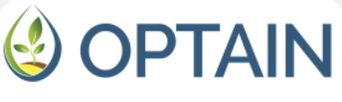
OPTAIN
„Optimal strategies to retain and re-use water and nutrients in small agricultural catchments across different soil-climatic regions in Europe“ (2020–2026)
Objective: retention & reuse of water and nutrients in small catchments.
Scope: developing and testing solutions for water and nutrient retention and reuse.
Impact: resilient water management in Continental, Pannonian, Boreal regions.
Notes:
OPTAIN is a project about smarter use of water and nutrients in agriculture. Its main objective is to find practical ways to retain and reuse water and nutrients in small catchments.
The project develops and tests different solutions across Europe – in Continental, Pannonian, and Boreal regions. By involving farmers, advisors and researchers, it ensures that these practices are not only technically sound but also feasible in real farm condition

Slide 11
AdvisoryNetPEST
„EU Advisory Networks to Reduce the Use and Risks of Pesticides in Europe“ (2024–2028)
Objective: build a European network of advisory services to reduce pesticide use and risks across EU.
Scope: supporting the transition towards safer crop protection methods.
Impact: safer food, protected biodiversity, and more sustainable farming.
Notes:
AdvisoryNetPEST is an international project that focuses on reducing the use and risks of pesticides across the European Union.
The main objective is to build a strong network of advisory services that can guide farmers towards safer and more sustainable crop protection methods. For farmers, this means access to practical, science-based advice that helps them reduce chemical dependency without losing productivity. For advisors, it provides opportunities for cross-border cooperation and exchange of innovative solutions.
The impact is clear: safer food for consumers, protection of biodiversity, and more sustainable farming aligned with the EU Green Deal and the Farm to Fork strategy.

Slide 12
How international projects support the future of farming
Notes:
So far, I have briefly presented LAAS projects – now let’s look at the contribution of international projects to developing and implementing innovations.

Slide 13
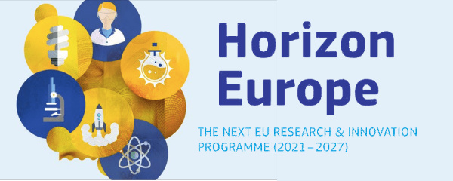
“Horizon Europe“ for agriculture
Digitalisation & precision farming
Agroecology & soil health
Food security & biodiversity
Sustainable & resilient farming systems
Notes:
Horizon Europe is the main EU research and innovation programme, and agriculture is one of its key focus areas.
First, it supports projects on digitalisation and precision farming, bringing new technologies directly to the field.
Second, it promotes agroecology and soil health, ensuring that we manage our natural resources more sustainably.
Third, it contributes to food security and biodiversity, by supporting farming practices that protect ecosystems while producing safe food.
And finally, it drives sustainable and resilient farming systems, helping farmers to adapt to climate change and remain competitive.
For advisors and farmers, this means access to innovations, tools, and methods developed across Europe, which can then be applied in our national context.

Slide 14
Innovation support through international projects
Shared solutions to global challenges
Knowledge exchange across countries
Faster adoption of innovations
Alignment with EU Green Deal & Farm to Fork
Notes:
International projects allow us to work together across countries and find shared solutions to global challenges such as climate change, biodiversity loss, and resources efficiency.
They also create opportunities for knowledge exchange – advisors and farmers learn from colleagues in other countries, seeing first-hand how new practices work in different conditions.
Another key contribution is that projects accelerate the adoption of innovations. International projects bring tools, methods, and technologies directly into practice.
Finally, these projects align with EU strategies like the Green Deal and the Farm to Fork strategy, ensuring that our national agriculture moves in the same direction as European policy goals.

Slide 15
How international projects foster innovation
networking community of practice (CoP)
cross-visits peer-to-peer learning training
expert groups demo events testing new tools & practices
knowledge transfer strengthening of national AKIS
Notes:
International projects do not only produce research results – they create real opportunities for farmers and advisors to learn, test, and apply innovations.
Through cross-visits and peer-to-peer learning, we see how practices work in other countries and bring this knowledge back home. Trainings and demo events give both farmers and advisors hands-on experience with new tools.
Advisors participate in expert groups and communities of practice, ensuring that knowledge is shared across Europe. And by testing new practices directly on farms, we make sure that innovations are practical and adapted to local conditions.
Finally, these activities strengthen national AKIS‘s – the Agricultural Knowledge and Innovation System

Slide 16
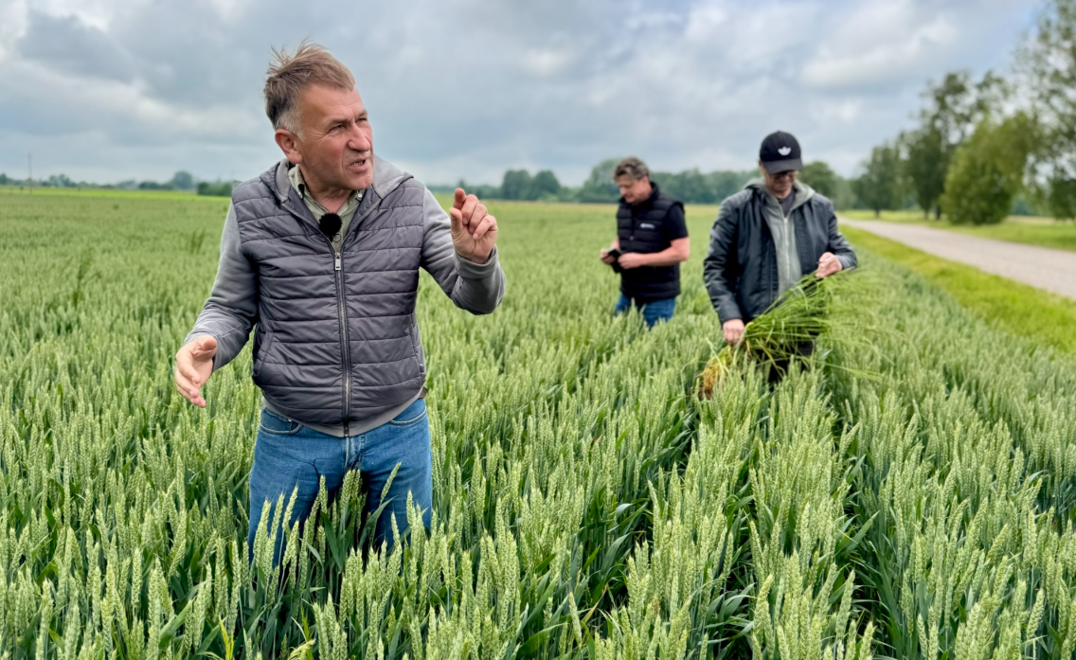
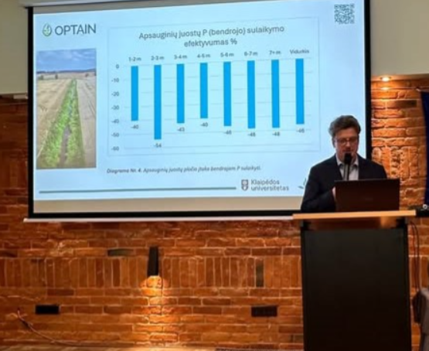
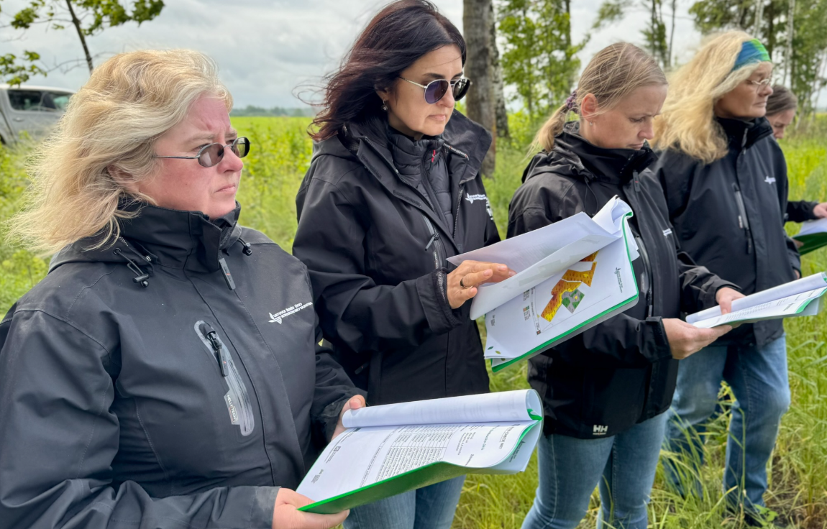
Experience of LAAS
Trainings & cross-visits
Developing digital solutions
Hosting international exchanges
Testing pilot tools on farms
Advisors in expert groups
Adapting innovations to local conditions
Notes:
LAAS has long-term experience in international projects.
We actively organise trainings and cross-visits, which allow both farmers and advisors to learn directly from each other. We are also involved in developing digital solutions.
As a host organisation, we welcome international partners – these exchanges create valuable opportunities to share practices.
In addition, we test pilot tools directly on farms, making sure that innovations are practical and adapted to real conditions. Our advisors participate in European expert groups, where they contribute knowledge and gain insights from colleagues abroad.
Finally, one of our strengths is the ability to adapt innovations to local conditions, so that European solutions work effectively in Lithuanian farming.

Slide 17
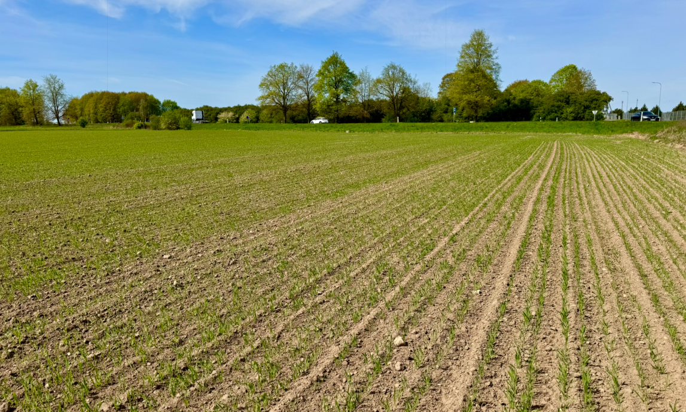
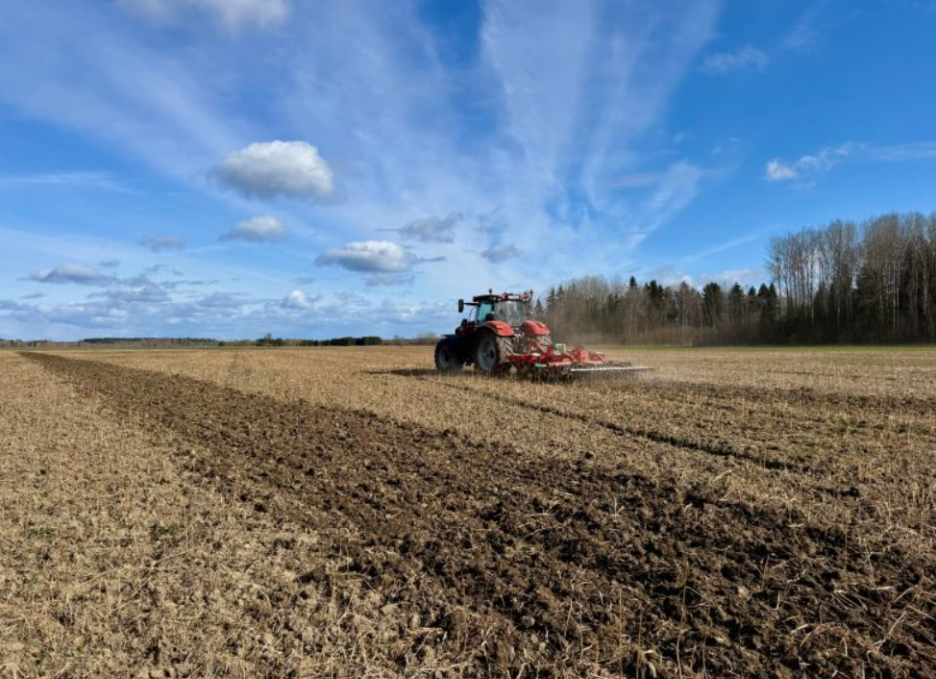
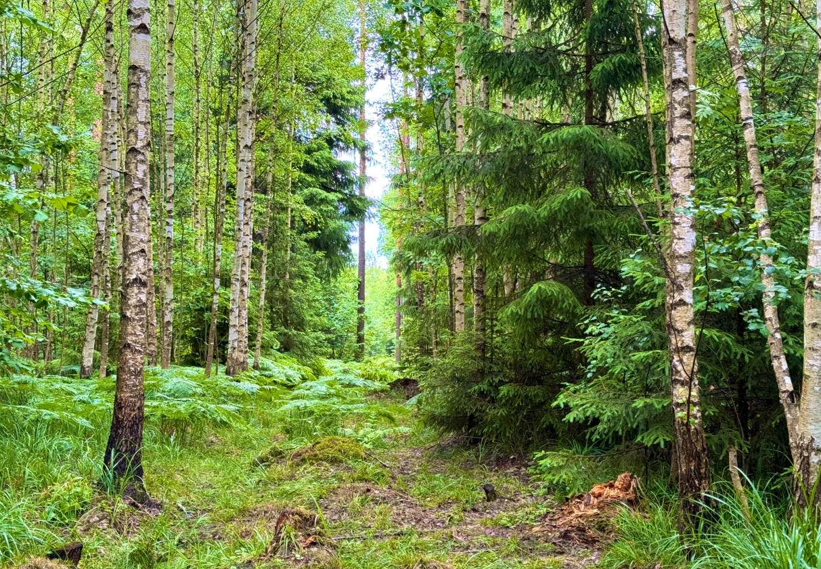
Experience of LAAS: challenges
Language barriers
Different levels of farmer motivation
Long-term results not always visible
Need for stronger cooperation
Notes:
First, there are language barriers – not all farmers and even some advisors feel comfortable in English, which can limit direct exchange.
Second, there are different levels of farmer motivation. Some are eager to test innovations, while others are more cautious, which affects how fast results can be seen.
Third, long-term results are not always visible right away. Some innovations need time to show benefits, which can sometimes make it difficult to keep farmers engaged.
And finally, there is a need for stronger cooperation. To make the most of international projects, collaboration between researchers, advisors, and farmers has to be continuous, not just during project activities.

Slide 18
Impact of international projects
Sustainability: CO₂ reduction, water & energy savings, ...
Innovation: AI, robotics, biotechnologies, digital tools, ...
Social impact: cooperation, rural development, knowledge transfer, ...
Notes:
International projects create impact in several ways.
First, they contribute to sustainability – helping to reduce CO₂ emissions, save water and energy, and improve soil health. These projects support farmers in moving towards more climate-friendly and resource-efficient practices.
Second, they drive innovation. Many projects introduce digital tools, artificial intelligence, robotics, and biotechnologies, which make farming more efficient and competitive.
And third, they have a strong social impact. By encouraging cooperation, supporting rural development, and enabling knowledge transfer, international projects strengthen farming communities and advisory systems across Europe.

Slide 19
Main takeaways
International projects connect researchers, advisors and farmers.
They bring innovations closer to practice.
They support sustainable, digital and resilient farming.
True innovation requires cooperation across different countries.
Notes:
To conclude, there are three main messages I would like to emphasise.
First, international projects connect researchers, advisors, and farmers. This cooperation is crucial because it ensures that knowledge and innovations move smoothly from science to practice.
Second, they bring innovations closer to the field. New tools and methods are tested and adapted in real farms, with advisors supporting the process.
Third, international projects support sustainable, digital, and resilient farming. They help agriculture to become more climate-friendly, more competitive, and better prepared for future challenges.
One of the most important lessons is that innovation requires cooperation across different countries, where we learn from each other’s experiences and adapt solutions to local conditions. International projects make this cross-country collaboration possible.

Slide 20
Thank you!

