Slide 1
Development of the Common Earth Observation Data Baltic Platform for National Government Organizations (EO-BALP)
Zane Atstāja
25.09.2025.

Slide 2
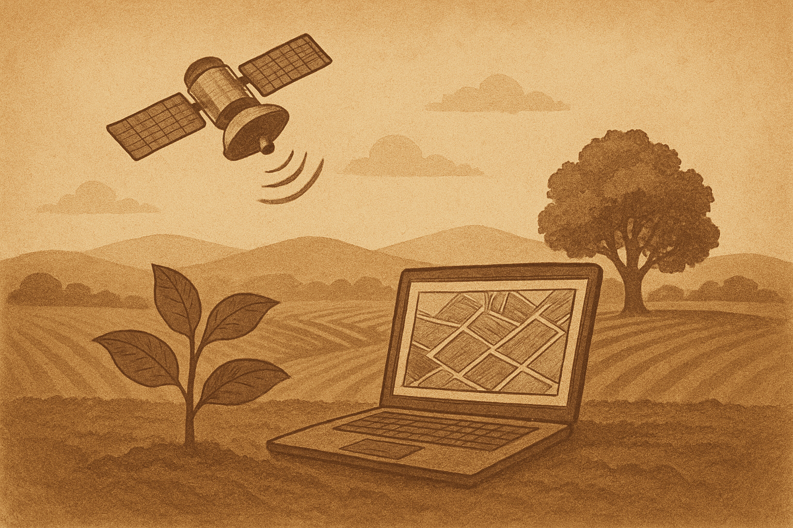
Contents
The project
The platform
Applications
Future

Slide 3





The EO-BALP project
Baltic Satellite Service and partners from Latvia, Lithuania and Estonia, funded by ESA
Technological and collaborative effort to leverage earth observation (EO) data for governmental services within the Baltic region
The project aims to create a common Baltic platform for the efficient use and processing of satellite data to support a variety of public services and environmental monitoring initiatives.
Notes:
The EO-BALP project https://eo4society.esa.int/projects/eo-balp/, initiated under the collaboration of Baltic Satellite Service Ltd. and its partners from Latvia, Lithuania, and Estonia, represents a significant technological and collaborative effort to leverage earth observation (EO) data for governmental services within the Baltic region. Signed on October 27, 2023, with the European Space Agency through agreement nr. 4000142702/23/I-NB, t
The EO-BALP project promises to significantly enhance environmental monitoring, resource management, and public service delivery across the Baltic region by providing accurate and timely access to satellite data. Its collaborative and technology-driven approach aims to support sustainable development, improve decision-making processes, and enhance regional safety and security through advanced earth observation capabilities.

Slide 4
GeoHub.net Platform
Transforms EO data into operational, sector-specific services
Addresses the core Green Deal priorities:
  climate resilience (flood, fire, forest services, GHG emission calculation tool in bog areas)
  biodiversity (habitat monitoring, water quality monitoring services)
  sustainable agriculture (Farmers Parliament DIH)
  digital transition (utilities, municipalities)
Provides data-to-decision gap:
  despite large EO data availability (e.g., Copernicus), Green Deal actors (R&D, farmers, foresters, municipalities, energy companies, etc.) often lack scalable, user-friendly tools to turn raw data into actionable insights.
Supports security related applications (maritime monitoring, change detection, infrastructure and settlement monitoring) and many more.

Slide 5
GeoHub.net Platform
https://app.geohub.net
Enhances integration with existing platforms through:
  Data Import: Enables importing geospatial data from various sources for specialized service provision.
  Integration Features: Supports XYZ/TMS, WMS web services, and JSON/GeoJSON data integration for web application development.
  Data Publishing: Ensures specialized applications' geographic data are available in standard formats (XYZ/TMS, WMS, GeoJSON) for use in web applications and GIS software (QGIS, ArcGIS, etc).

Slide 6
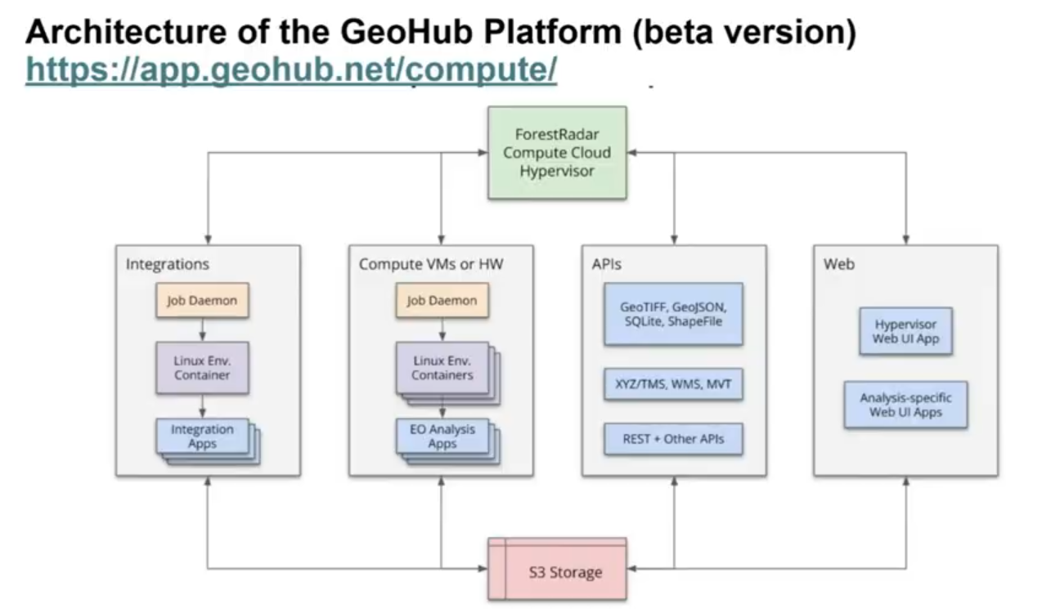
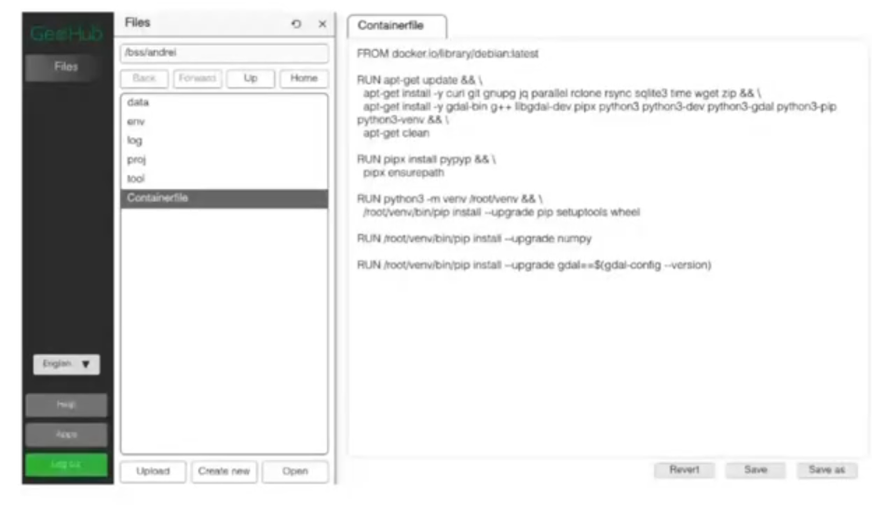
GeoHub.net Platform

Slide 7
GeoHub.net Platform
Designed for users without specific knowledge and also for professionals in the field.
Enables participating stakeholders in the three Baltic countries to deploy, operate and deliver EO-based services to national governments and institutions.
Allows users to discover and select data, pre-existing processing services, EO based services, products and applications, visualize and analyze them or select and apply data manipulation tools to the result.
WEB interface, command line, file transfer

Slide 8

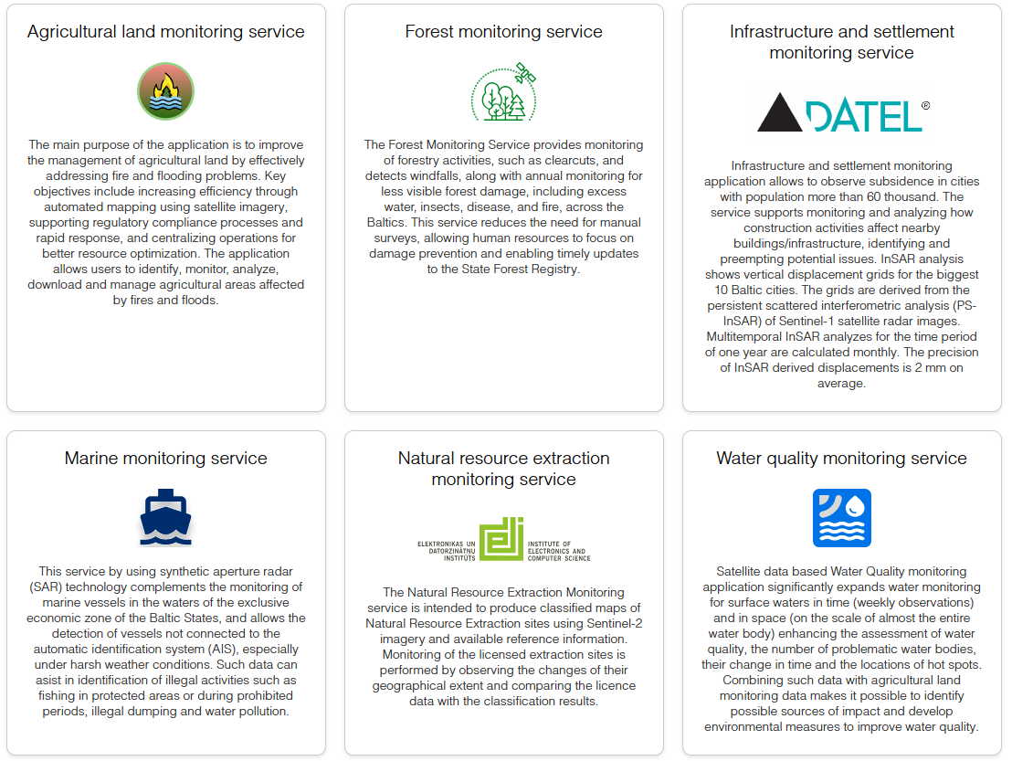
Applications
Notes:
This platform is intended to support the creation and deployment of six specialized applications, each designed to address different aspects of environmental and infrastructure monitoring:
Infrastructure and Settlement Monitoring: Focused on urban areas with populations exceeding 60,000, this application aims to utilize satellite data for the detection of ground movements and identification of potential hazards within infrastructure protection zones.
Water Quality Monitoring: This application is dedicated to assessing the quality of water, detecting pollution levels, and pinpointing the sources of pollution in the Baltic Sea, coastal areas, and inland water bodies.
Forest Change Monitoring: Designed to monitor forestry changes such as clear-cuts, windfalls, and damage from pests, diseases, fires, or water, it will also provide a satellite data mosaic service that covers the Baltic countries, offering up-to-date information on forest conditions.
Agricultural Land Monitoring: This tool will assist in identifying and assessing the impact of wildfires and flooding on agricultural lands, crucial for disaster response and agricultural planning.
Natural Resource Extraction Monitoring: Aimed at combating illegal extraction activities, this application will help in identifying unauthorized extraction sites for wood, sand, gravel, and other minerals.
Marine Monitoring: This application focuses on maritime activities, specifically identifying ships, their types, locations, and movements, to enhance maritime security and monitoring efforts.

Slide 9

Agricultural land monitoring app
Application as a useful tool to contribute to land management issues related to fire and flood.
Beneficiaries: National paying agencies, municipalities, insurance companies, agricultural administrations.

Slide 10
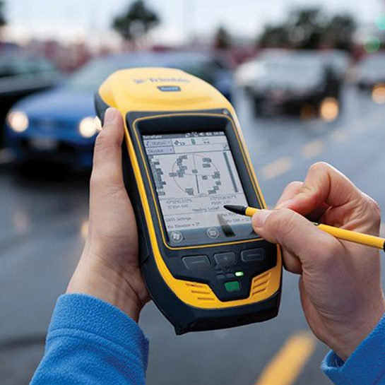
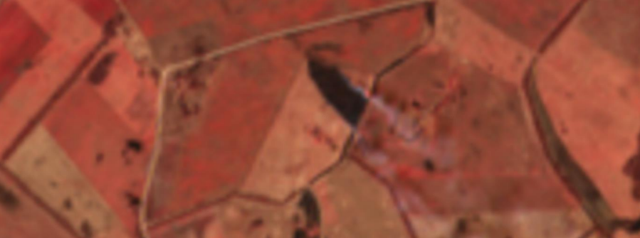
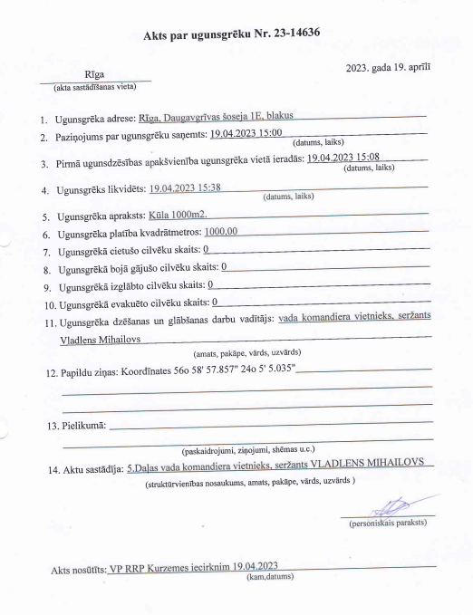
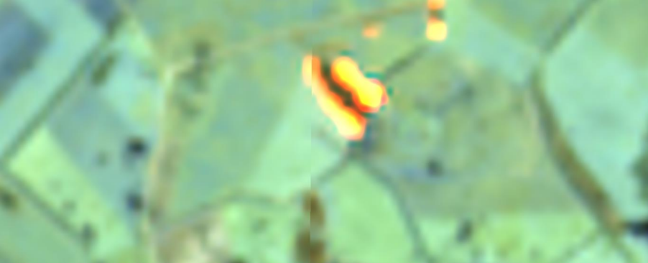
Mapping burning of old grass and straw
LLVS3 – Prohibition to burn straw or old grass
Identification of burned area in Reference parcels
Challenges:
  Firefighters’ data might not be complete
  Manual task

Slide 11

Burned area mapping
Burn scar mapping using satellite data is scientifically proved long time ago.
Normalized burn index (NBR) is defined to evaluate burn severity.
Sentinel-2 near infrared (NIR B09) and short-wave infrared (SWIR B12) bands are used to calculate NBR.
NBR is calculated for satellite imagery every week to allow continuous monitoring.
$$NBR=\frac{NIR−SWIR}{NIR+SWIR}$$

Slide 12
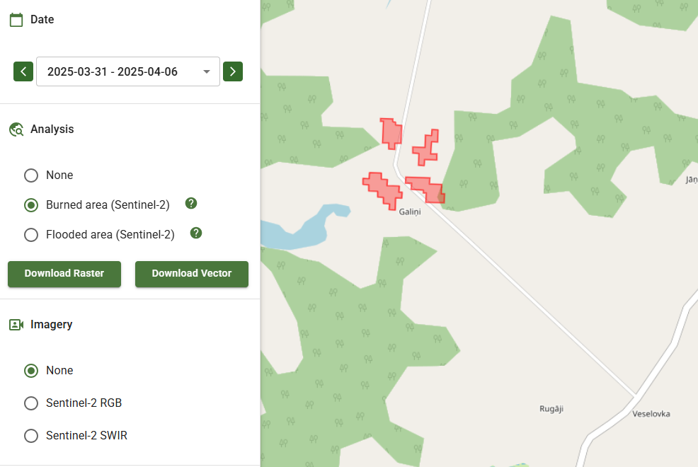
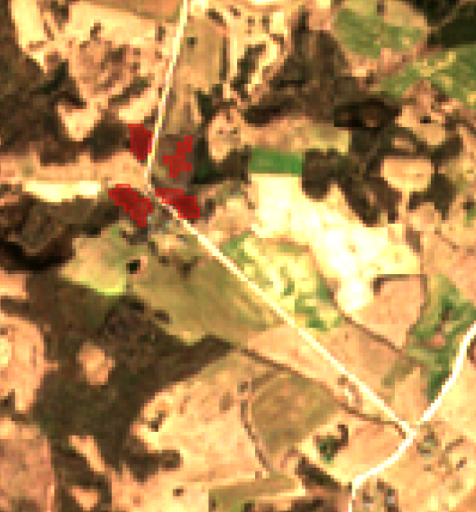
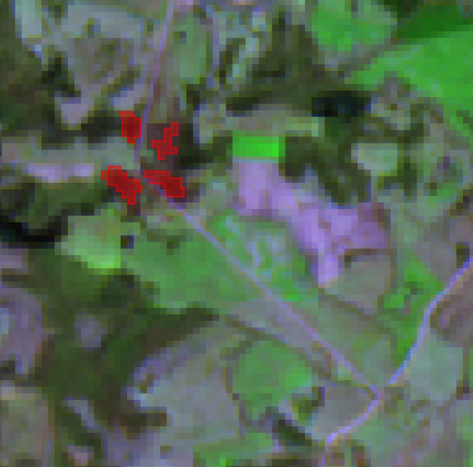
Burned area mapping
Automatically generated boundary of a burned area (red polygon) displayed on true colour Sentinel-2 image with 10 m resolution (middle) and on false colour SWIR image with 20 m resolution (right).

Slide 13

Flood mapping
Due to changing climate, flood risk increases each year.
Rapid mapping, timely action and reaction on emergency, and loss estimation.
Challenges – field visits, farmers information by phone, geo-tagged photos, a lot of information to process.
Flooded area mapping is defined as area that is covered by water during the flood.
Can be used only if the sky is clear (poor for longtime rainfall)
Normalized difference water index (NDWI) is used to map area that is covered by water. It uses green and infrared reflection (Sentinel-2 bands B03 and B08).

Slide 14
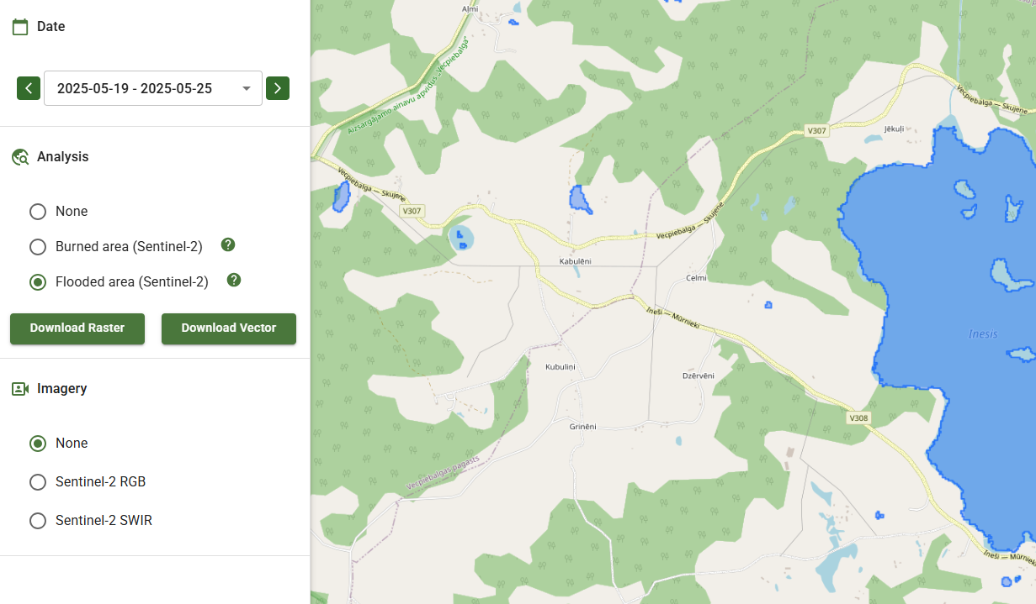
Flood map
Water area (blue polygons) is mapped every week for continuous monitoring.

Slide 15
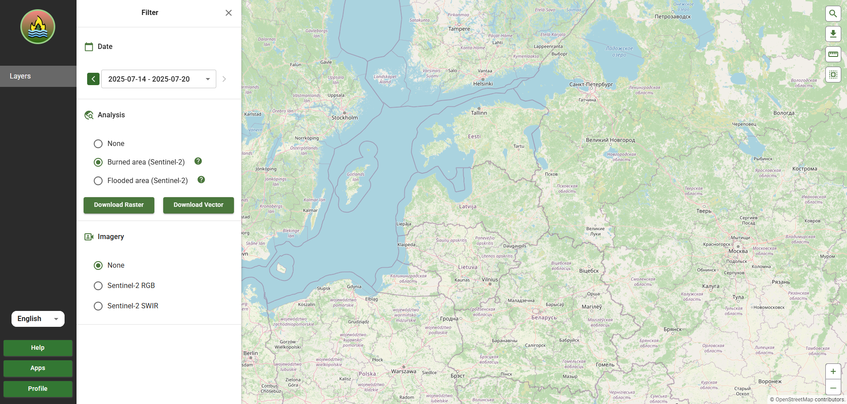
Select week for detection
Search location/coordinates
Measure area/distance
Draw/upload AOI
Fire or Flood?
Download
Select basemap imagery
Zoom in/out

Slide 16
Benefits from the application
Efficiency: Optimisation of mapping process, time and computation economy for all users.
Accuracy: use of Sentinel-2 to estimate affected area reduce need for manual inspections and field visits that might not cover full area.
Unified platform: avoid data processing multiple times by several users for similar task. Centralized approach improves efficiency and reduce need for computing power.

Slide 17
Improvements for Agri app
New data layers (parcels, cadastres, search)
New products for agriculture
Opportunity to create and publish applications to your organization or everyone through the platform
Good example – app.smartagro.lv

Slide 18
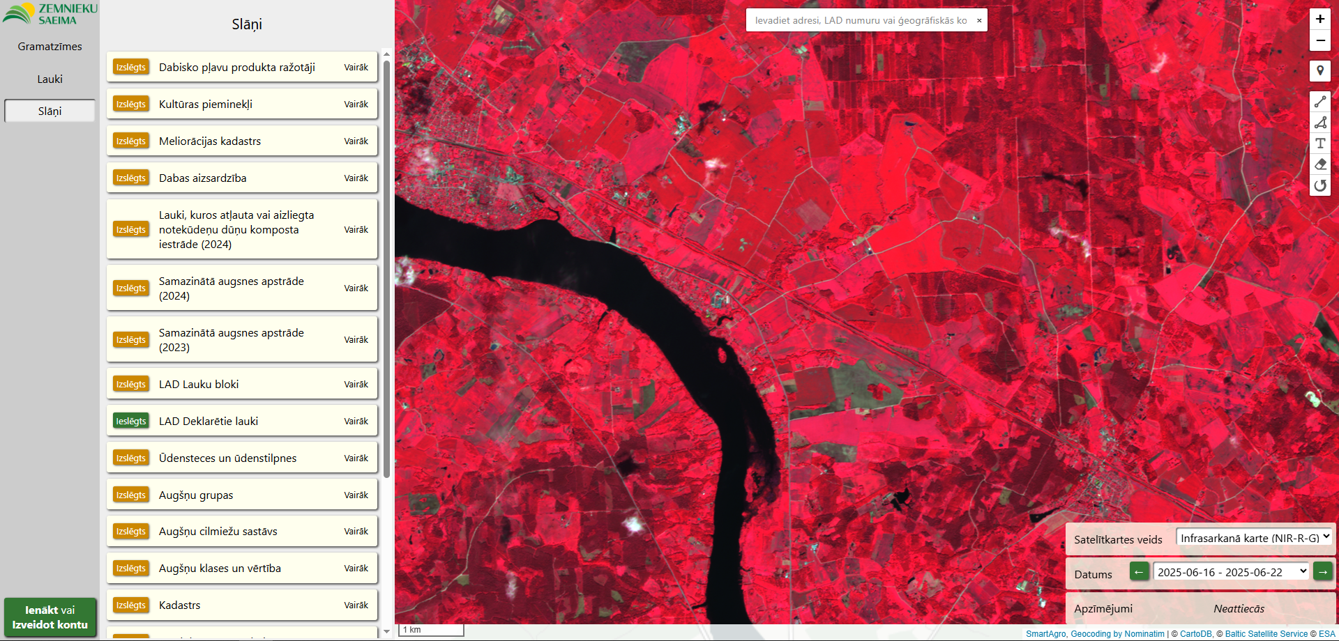
Example: app.SmartAgro.lv

Slide 19
Open apps integrated in GeoHub
Monitoring of the gas network using both satellite and drone imagery
Habitat Monitoring for Nature Conservation Agency: https://app.geohub.net/dap
Riga Technical University, API for calculation of the GHG emissions in peat bogs
Riga City Council, tools for green area change detection in neighborhoods, heat island maps, detection of overgrown lakes that need to be cleaned
ESA Project, Flood Monitoring Service: https://flood.forestradar.com
EUROSTARS project, Fully automated wildfire early detection system: https://fire2.forestradar.com
ERDF R&D project ForestRisk, detection of excess water in the forest from S1&S2, https://app.geohub.net/forest
ERDF R&D project Woodstock, development of forest stock estimation models
Smart Agro http://app.smartagro.lv

Slide 20
Future
Functionality improvement (multi-factor and third party authentification)
Bigger spatial coverage (Nordic countries, Poland)
More data
More applications

Slide 21
New apps, new regions
Subsidence of wooden buildings in Riga
ADNET from Croatia
Poland – Natural capital assessment and monitoring
EstLat forest maintenance recommendations
Platform distribution in Turkey
Sadales tīkls
Several new project proposals based on GeoHub
Notes:
Esam uzsākuši jau vairākus sadarbības projektus, kur visa platformas funkcionalitāte tiks pilnībā izmantota. Jā, Rīgas koka ēku projekts ir ESA apstiprināts jau, tāpat arī horvātu ADNET projekts, viņi nākamnedēļ brauc pie mums mācīties visu nedēļu, arī poļu projekts par viņu teritorijas eko servisiem ir CCN1 jau realizācijā, procesā, tad Sadales tīkls izmantos platformu, arī EstLat projektā meža kopšanas rekomendāciju serviss tiek taisīts platformā (jāpabeidz jau septembrī) arī priekš Igaunijas lietotājiem, esam noslēguši izplatīšanas līgumu par platformas licenci ar Turcijas uzņēmumu, kā arī iesnieguši 5 dažādus jaunus projektus, kur platforma tiks izmantota kā pamata projekta infrastruktūra un vēl ir iesniegts projekts kopā ar Tildi par valodas bota pievienošanu platformai, rudenī ar slovēņiem norunājām kopīgu ESA projektu rakstīt, jo viņiem būs ESA uzsaukums un arī grib izmantos mūsu platformu un vēl dažādas citas aktivitātes

Slide 22
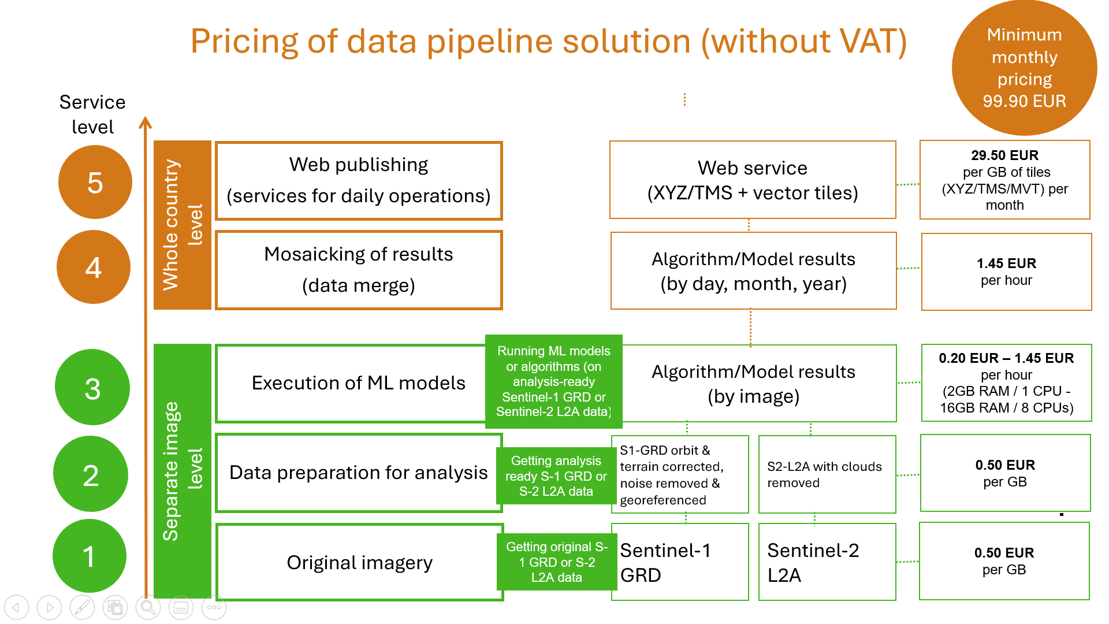
Pricing
Notes:
Clear and trnsparent pricing - From 99.90 for all organization – it givesaccess and full functionality for all users

Slide 23
Demo and collaboration
New interface and project updates will be presented at Big Data from Space (BiDS) conference in Riga 1-3 October + booth and live demo
ESA has extended EO-BALP project till the end of 2026
Platform offered through ESA NoR program
Open for collaboration, looking for users, data and service providers, training available
Contact Ilze Bargā, ilze@baltsat.lv
https://www.forestradar.com/projects/esa-eo-balp

Slide 24
Thank you for your attention!

